Slide 1


Basics of Autobooks
Capital
What You’ll Learn

Slide 2


What You’ll Learn
The Value of Autobooks Capital
Qualification & Approval
Taking a draw and repayment
Available Resources and Support

Slide 3

The Value of
Autobooks Capital
Notes:
Before we dive into WHAT the tools do, let’s see WHY these tools provide value to our customer; and HOW these tools help us achieve goals too.
---
GO TO NEXT SLIDE.

Slide 4

Picture this…
Tori, the owner of AAA Lawn Care, is gearing up for a busy summer season, where she'll make the bulk of her revenue. To get ready for the season, she needs to purchase about $10,000 worth of supplies and materials but her account balance is at its lowest of the year until summer arrives.
What can Tori do to get her business out of this jam?
What can YOU do to help her?

Slide 5
The Growing Demand for Small Business Capital
Over
60%
Capital lines between
$10k & $100k
of small businesses report cash flow as a primary challenge. Many struggle to cover payroll, rent, and inventory expenses.
are the most sought after by small business owners because they provide essential short-term liquidity without excessive debt burdens.
Traditional financial institutions have tightened lending requirements, leaving many small businesses to seek alternative finance options often through third-party providers.

Slide 6
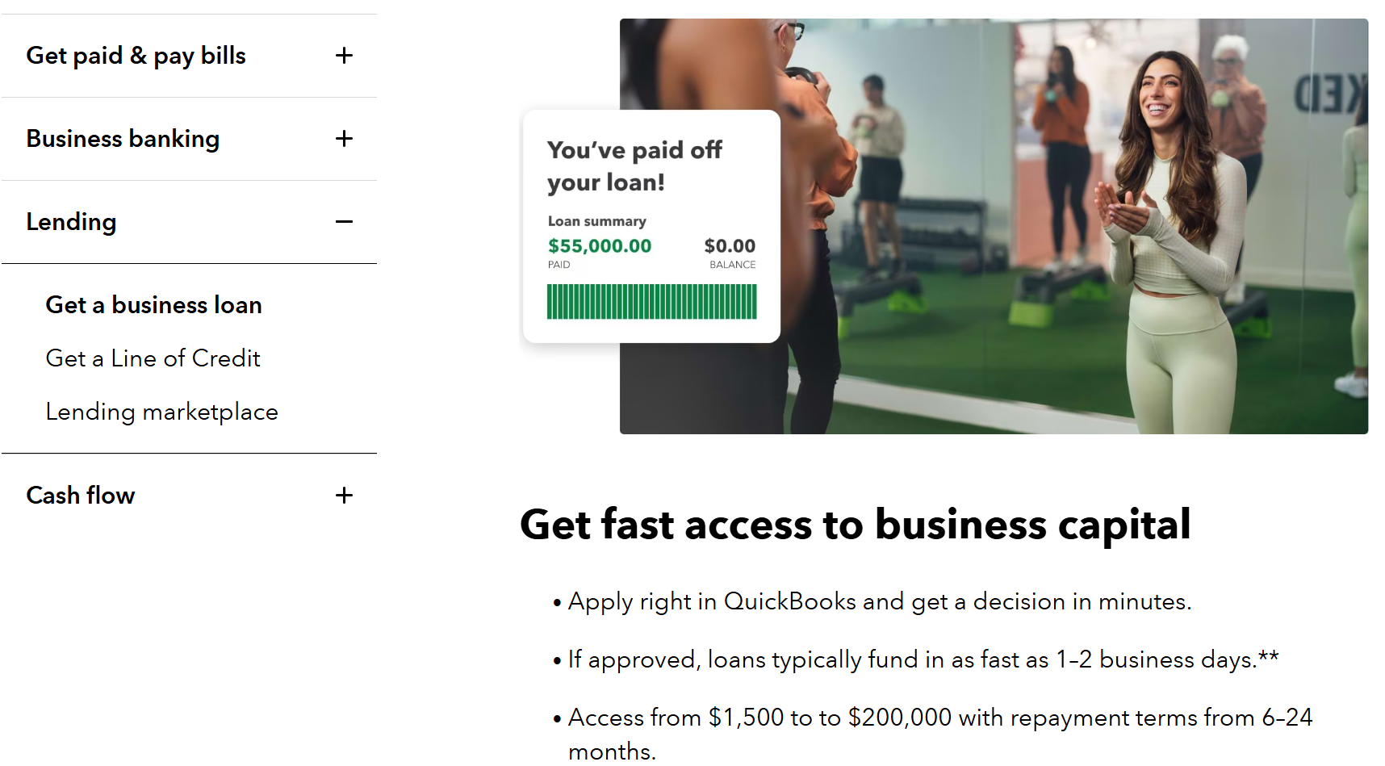
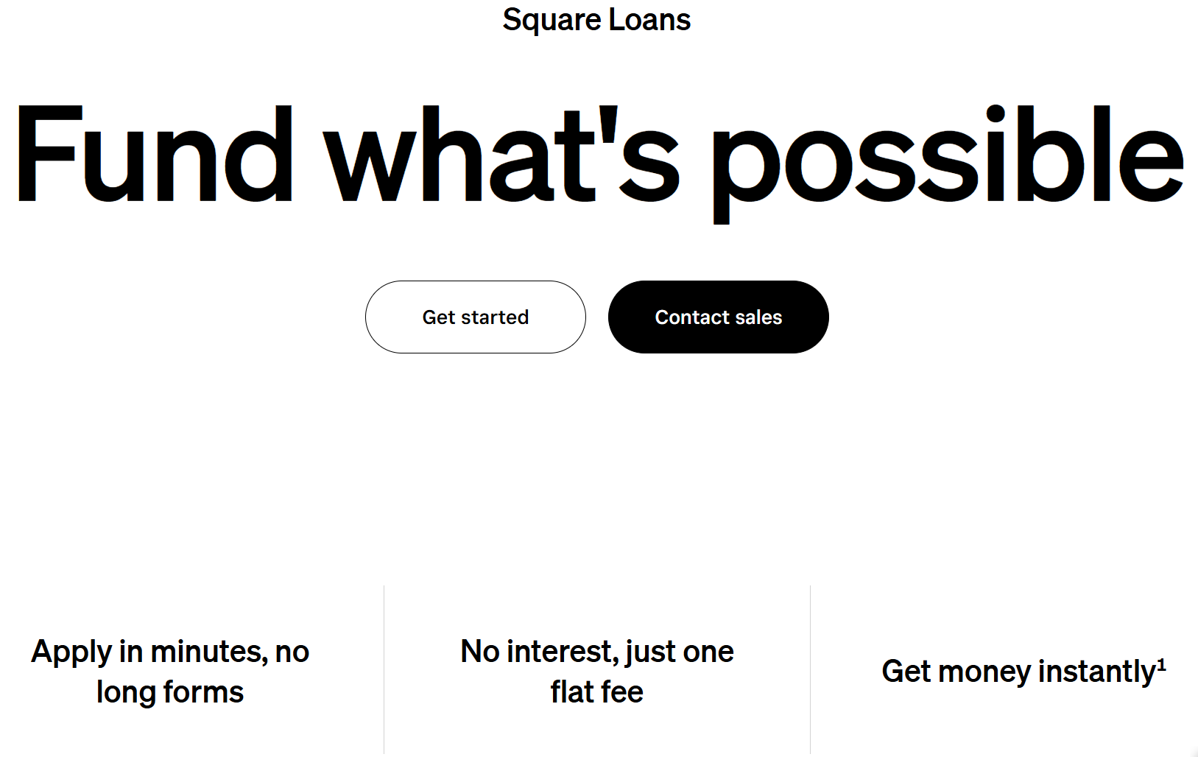
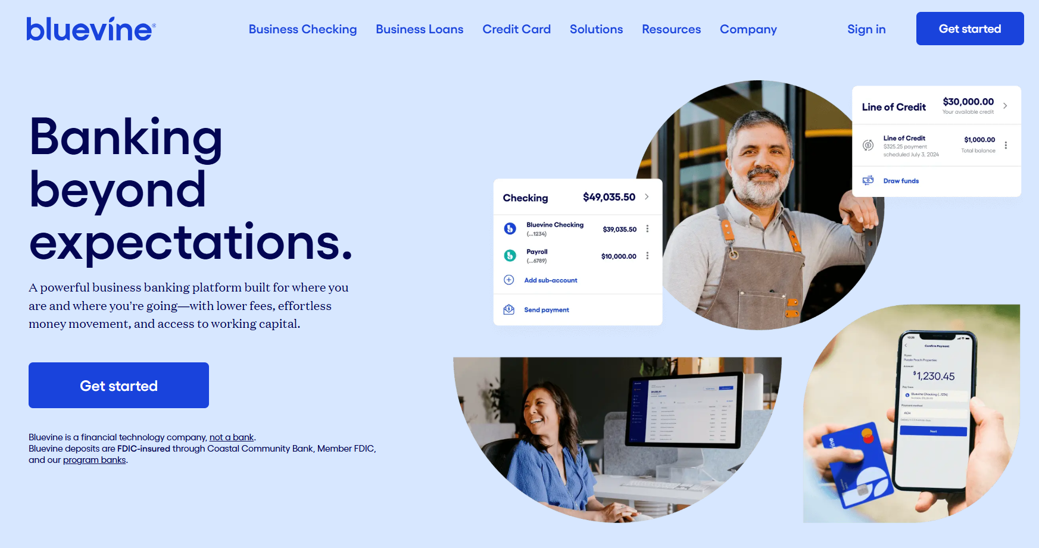
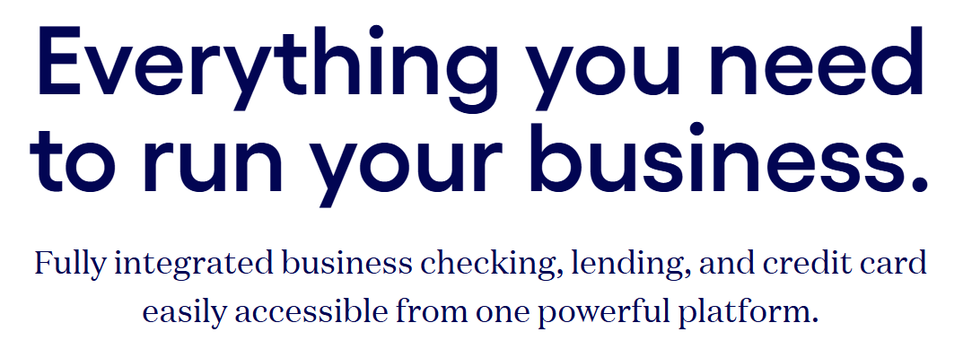
Third-party providers already meet that demand by providing capital products in addition to other standard banking products and services

Slide 7

Now YOU can write a happy ending to the story
Remember Tori, that was short $10,000 to kick off her summer lawn care season?
When you provide her with Autobooks Capital she'll be able to draw a cash advance to cover these upfront expenses.
She’ll repay the advance on a set schedule (or repay it in full once summer revenue starts coming in).
The business can draw on their capital advance line as needed; their job schedule can continue without any cashflow bumps.

Slide 8
Qualification &
Approval
Notes:
Before we dive into WHAT the tools do, let’s see WHY these tools provide value to our customer; and HOW these tools help us achieve goals too.
---
GO TO NEXT SLIDE.

Slide 9

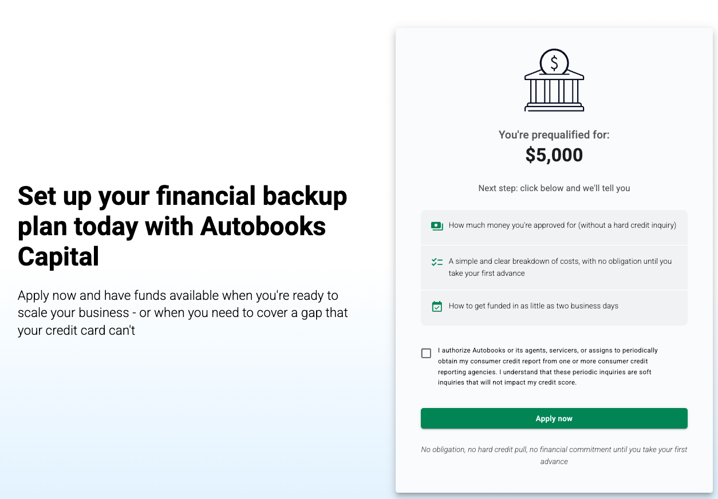
The Pre-qualification
Minimum requirements of their primary checking account to qualify:
20+ transactions in the account within the last 90 days
4+ deposit transactions in the last 90 days
1 or more deposit transactions in the last 30 days
A customer will be evaluated for eligibility once they accept Autobooks terms of service. If they qualify, the pre-qualification offer details will appear in the Capital tab.
Notes:
You can identify opportunities, passively, by looking at account transactions. And your customers don’t even have to be physically present to see these opportunities.
There are several hundred customers within a typical bank that use third party payment apps to get paid, which makes a perfect opportunity to make them aware of our new solution!
Does your customer receive regular deposits from Square, Venmo, PayPal, Stripe, etc? This new solution offers the same features as these payment apps, but with the added benefit of being a part of their bank account.
No juggling multiple applications and multiple login credentials to different apps and websites.
Payments go right to the customer’s bank account instead of being held in a third-party virtual wallet.
No more manually matching deposits to outstanding invoices
-----------------------------------------------------------------------------------
Another way that you can identify customers is to think about the services they would benefit from.
Again, this does not have to be done “in-person” but it can serve as a middle ground between in-person conversations and passively thinking of customer opportunities.
If your customer needs (CLICK FOR ANIMATION, READ BULLETS AS THEY APPEAR).
Some business type examples include (CLICK FOR ANIMATION, READ BULLETS AS THEY APPEAR).
If your customer has a business like these, or needs these services, it’s great to be proactive in conversations with them and moving them towards enrollment.
-----------------------------------------------------------------------------------
Here are some circumstances you can listen for when talking to your customer that indicate Autobooks may be a good fit for them:
Chaos: do you know a customer that is struggling to keep up with managing their business? Maybe they’re falling behind on collecting overdue payments from customers, or maybe they’re spending hours and hours manually tracking payments and creating invoices. Autobooks technology automates many manual tracking steps for a business.
Trust: Some customers have tried other third-party payment apps and have had a negative experience. Bad customer support, tech issues, or just too difficult to use. Autobooks appeals to customers that have been burned in the past since the solution is baked right into their bank account. Customers know they can trust the services you provide, and they love your customer service. Plus, you’ve got the Autobooks team providing great customer service too!
New Beginnings: It’s a great time to discuss Autobooks when you open new customer accounts! The solution is easy to use, and easy to get started…and priced right for new business owners.

Slide 10
The Pre-qualification
If the customer is not eligible, they won't see the Capital tab in our application.
If the customer is not immediately eligible, we'll reevaluate eligibility each time the customer logs in to Autobooks.
Notes:
You can identify opportunities, passively, by looking at account transactions. And your customers don’t even have to be physically present to see these opportunities.
There are several hundred customers within a typical bank that use third party payment apps to get paid, which makes a perfect opportunity to make them aware of our new solution!
Does your customer receive regular deposits from Square, Venmo, PayPal, Stripe, etc? This new solution offers the same features as these payment apps, but with the added benefit of being a part of their bank account.
No juggling multiple applications and multiple login credentials to different apps and websites.
Payments go right to the customer’s bank account instead of being held in a third-party virtual wallet.
No more manually matching deposits to outstanding invoices
-----------------------------------------------------------------------------------
Another way that you can identify customers is to think about the services they would benefit from.
Again, this does not have to be done “in-person” but it can serve as a middle ground between in-person conversations and passively thinking of customer opportunities.
If your customer needs (CLICK FOR ANIMATION, READ BULLETS AS THEY APPEAR).
Some business type examples include (CLICK FOR ANIMATION, READ BULLETS AS THEY APPEAR).
If your customer has a business like these, or needs these services, it’s great to be proactive in conversations with them and moving them towards enrollment.
-----------------------------------------------------------------------------------
Here are some circumstances you can listen for when talking to your customer that indicate Autobooks may be a good fit for them:
Chaos: do you know a customer that is struggling to keep up with managing their business? Maybe they’re falling behind on collecting overdue payments from customers, or maybe they’re spending hours and hours manually tracking payments and creating invoices. Autobooks technology automates many manual tracking steps for a business.
Trust: Some customers have tried other third-party payment apps and have had a negative experience. Bad customer support, tech issues, or just too difficult to use. Autobooks appeals to customers that have been burned in the past since the solution is baked right into their bank account. Customers know they can trust the services you provide, and they love your customer service. Plus, you’ve got the Autobooks team providing great customer service too!
New Beginnings: It’s a great time to discuss Autobooks when you open new customer accounts! The solution is easy to use, and easy to get started…and priced right for new business owners.

Slide 11
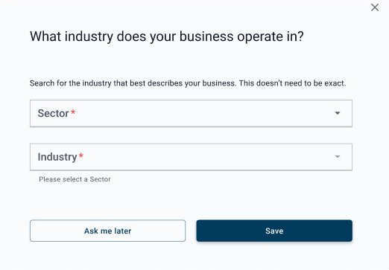
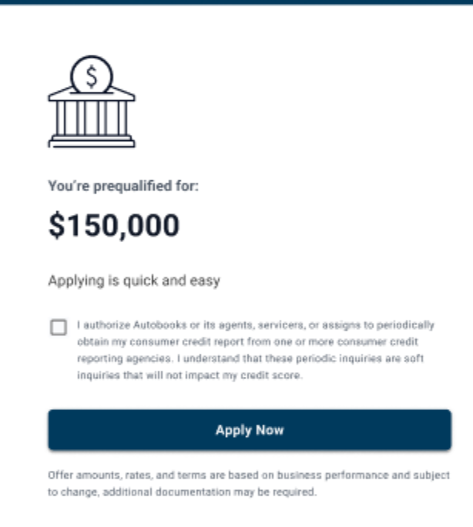
The Application
Once pre-qualified, the customer applies in-app for Autobooks Capital through these steps:
Clicks the Apply Now button in the Capital tab.
Completes basic questions about the business.
Optional: may be asked to clarify information or contribute documents.
Notes:
You can identify opportunities, passively, by looking at account transactions. And your customers don’t even have to be physically present to see these opportunities.
There are several hundred customers within a typical bank that use third party payment apps to get paid, which makes a perfect opportunity to make them aware of our new solution!
Does your customer receive regular deposits from Square, Venmo, PayPal, Stripe, etc? This new solution offers the same features as these payment apps, but with the added benefit of being a part of their bank account.
No juggling multiple applications and multiple login credentials to different apps and websites.
Payments go right to the customer’s bank account instead of being held in a third-party virtual wallet.
No more manually matching deposits to outstanding invoices
-----------------------------------------------------------------------------------
Another way that you can identify customers is to think about the services they would benefit from.
Again, this does not have to be done “in-person” but it can serve as a middle ground between in-person conversations and passively thinking of customer opportunities.
If your customer needs (CLICK FOR ANIMATION, READ BULLETS AS THEY APPEAR).
Some business type examples include (CLICK FOR ANIMATION, READ BULLETS AS THEY APPEAR).
If your customer has a business like these, or needs these services, it’s great to be proactive in conversations with them and moving them towards enrollment.
-----------------------------------------------------------------------------------
Here are some circumstances you can listen for when talking to your customer that indicate Autobooks may be a good fit for them:
Chaos: do you know a customer that is struggling to keep up with managing their business? Maybe they’re falling behind on collecting overdue payments from customers, or maybe they’re spending hours and hours manually tracking payments and creating invoices. Autobooks technology automates many manual tracking steps for a business.
Trust: Some customers have tried other third-party payment apps and have had a negative experience. Bad customer support, tech issues, or just too difficult to use. Autobooks appeals to customers that have been burned in the past since the solution is baked right into their bank account. Customers know they can trust the services you provide, and they love your customer service. Plus, you’ve got the Autobooks team providing great customer service too!
New Beginnings: It’s a great time to discuss Autobooks when you open new customer accounts! The solution is easy to use, and easy to get started…and priced right for new business owners.

Slide 12
Approval Process - Summary
SMB signs up for Autobooks
SMB is
evaluated for prequalification
Prequalified SMBs
see the Autobooks Capital tab, presented an offer
Interested SMBs may apply through the Autobooks app
SMB application is reviewed and decisioned
Approved SMBs may begin pulling down their capital advance immediately
Notes:
You can identify opportunities, passively, by looking at account transactions. And your customers don’t even have to be physically present to see these opportunities.
There are several hundred customers within a typical bank that use third party payment apps to get paid, which makes a perfect opportunity to make them aware of our new solution!
Does your customer receive regular deposits from Square, Venmo, PayPal, Stripe, etc? This new solution offers the same features as these payment apps, but with the added benefit of being a part of their bank account.
No juggling multiple applications and multiple login credentials to different apps and websites.
Payments go right to the customer’s bank account instead of being held in a third-party virtual wallet.
No more manually matching deposits to outstanding invoices
-----------------------------------------------------------------------------------
Another way that you can identify customers is to think about the services they would benefit from.
Again, this does not have to be done “in-person” but it can serve as a middle ground between in-person conversations and passively thinking of customer opportunities.
If your customer needs (CLICK FOR ANIMATION, READ BULLETS AS THEY APPEAR).
Some business type examples include (CLICK FOR ANIMATION, READ BULLETS AS THEY APPEAR).
If your customer has a business like these, or needs these services, it’s great to be proactive in conversations with them and moving them towards enrollment.
-----------------------------------------------------------------------------------
Here are some circumstances you can listen for when talking to your customer that indicate Autobooks may be a good fit for them:
Chaos: do you know a customer that is struggling to keep up with managing their business? Maybe they’re falling behind on collecting overdue payments from customers, or maybe they’re spending hours and hours manually tracking payments and creating invoices. Autobooks technology automates many manual tracking steps for a business.
Trust: Some customers have tried other third-party payment apps and have had a negative experience. Bad customer support, tech issues, or just too difficult to use. Autobooks appeals to customers that have been burned in the past since the solution is baked right into their bank account. Customers know they can trust the services you provide, and they love your customer service. Plus, you’ve got the Autobooks team providing great customer service too!
New Beginnings: It’s a great time to discuss Autobooks when you open new customer accounts! The solution is easy to use, and easy to get started…and priced right for new business owners.

Slide 13
Taking a Draw
and Repayments
Notes:
Before we dive into WHAT the tools do, let’s see WHY these tools provide value to our customer; and HOW these tools help us achieve goals too.
---
GO TO NEXT SLIDE.

Slide 14
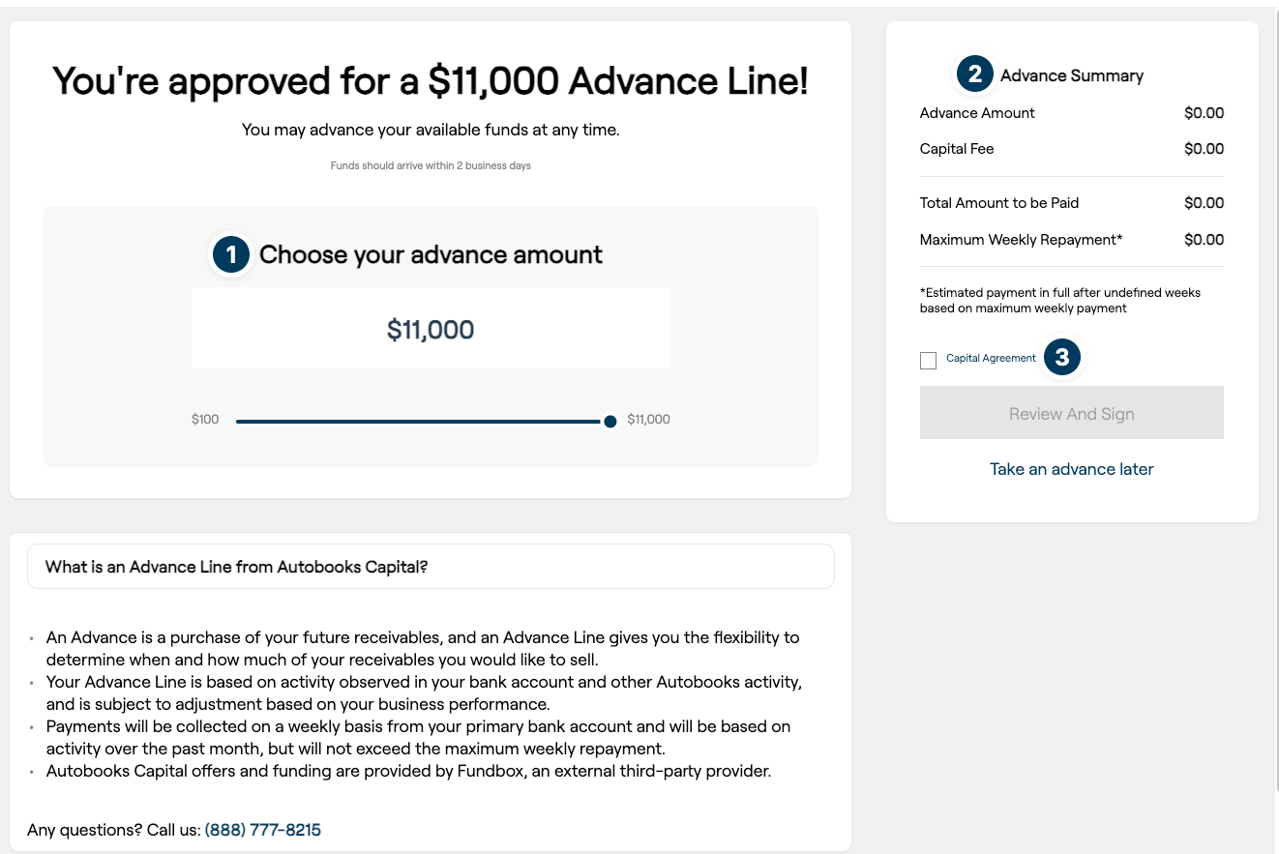
The initial draw
The SMB will:
Choose their advance amount.
The Advance Summary will show the advance terms.
The SMB must check the accept terms box, then click Accept to finalize the draw.
Notes:
You can identify opportunities, passively, by looking at account transactions. And your customers don’t even have to be physically present to see these opportunities.
There are several hundred customers within a typical bank that use third party payment apps to get paid, which makes a perfect opportunity to make them aware of our new solution!
Does your customer receive regular deposits from Square, Venmo, PayPal, Stripe, etc? This new solution offers the same features as these payment apps, but with the added benefit of being a part of their bank account.
No juggling multiple applications and multiple login credentials to different apps and websites.
Payments go right to the customer’s bank account instead of being held in a third-party virtual wallet.
No more manually matching deposits to outstanding invoices
-----------------------------------------------------------------------------------
Another way that you can identify customers is to think about the services they would benefit from.
Again, this does not have to be done “in-person” but it can serve as a middle ground between in-person conversations and passively thinking of customer opportunities.
If your customer needs (CLICK FOR ANIMATION, READ BULLETS AS THEY APPEAR).
Some business type examples include (CLICK FOR ANIMATION, READ BULLETS AS THEY APPEAR).
If your customer has a business like these, or needs these services, it’s great to be proactive in conversations with them and moving them towards enrollment.
-----------------------------------------------------------------------------------
Here are some circumstances you can listen for when talking to your customer that indicate Autobooks may be a good fit for them:
Chaos: do you know a customer that is struggling to keep up with managing their business? Maybe they’re falling behind on collecting overdue payments from customers, or maybe they’re spending hours and hours manually tracking payments and creating invoices. Autobooks technology automates many manual tracking steps for a business.
Trust: Some customers have tried other third-party payment apps and have had a negative experience. Bad customer support, tech issues, or just too difficult to use. Autobooks appeals to customers that have been burned in the past since the solution is baked right into their bank account. Customers know they can trust the services you provide, and they love your customer service. Plus, you’ve got the Autobooks team providing great customer service too!
New Beginnings: It’s a great time to discuss Autobooks when you open new customer accounts! The solution is easy to use, and easy to get started…and priced right for new business owners.

Slide 15
Repayment of draws
Initial Draw
Weekly repayment debit
Repayment of draw in full
Available advance line increases
Notes on repayment:
Repayment is spread over a set number of weeks, determined at the time of draw
The SMB is allowed to have concurrent draws, if the total drawn funds doesn’t exceed their approved line amount
If the SMB is unable to make a weekly payment, Autobooks will work with the SMB to refigure terms
Notes:
You can identify opportunities, passively, by looking at account transactions. And your customers don’t even have to be physically present to see these opportunities.
There are several hundred customers within a typical bank that use third party payment apps to get paid, which makes a perfect opportunity to make them aware of our new solution!
Does your customer receive regular deposits from Square, Venmo, PayPal, Stripe, etc? This new solution offers the same features as these payment apps, but with the added benefit of being a part of their bank account.
No juggling multiple applications and multiple login credentials to different apps and websites.
Payments go right to the customer’s bank account instead of being held in a third-party virtual wallet.
No more manually matching deposits to outstanding invoices
-----------------------------------------------------------------------------------
Another way that you can identify customers is to think about the services they would benefit from.
Again, this does not have to be done “in-person” but it can serve as a middle ground between in-person conversations and passively thinking of customer opportunities.
If your customer needs (CLICK FOR ANIMATION, READ BULLETS AS THEY APPEAR).
Some business type examples include (CLICK FOR ANIMATION, READ BULLETS AS THEY APPEAR).
If your customer has a business like these, or needs these services, it’s great to be proactive in conversations with them and moving them towards enrollment.
-----------------------------------------------------------------------------------
Here are some circumstances you can listen for when talking to your customer that indicate Autobooks may be a good fit for them:
Chaos: do you know a customer that is struggling to keep up with managing their business? Maybe they’re falling behind on collecting overdue payments from customers, or maybe they’re spending hours and hours manually tracking payments and creating invoices. Autobooks technology automates many manual tracking steps for a business.
Trust: Some customers have tried other third-party payment apps and have had a negative experience. Bad customer support, tech issues, or just too difficult to use. Autobooks appeals to customers that have been burned in the past since the solution is baked right into their bank account. Customers know they can trust the services you provide, and they love your customer service. Plus, you’ve got the Autobooks team providing great customer service too!
New Beginnings: It’s a great time to discuss Autobooks when you open new customer accounts! The solution is easy to use, and easy to get started…and priced right for new business owners.

Slide 16
Early repayment of draws
SMBs can repay any advance early!
When a SMB repays advances early, they receive a discount on the Funding fee.
Via ACH:
Next weekly debit will be for full draw repayment amount
Advance line capacity will update within 2 business days of repayment
Via credit or debit card:
Repayment will process immediately
Advance line capacity will update within 2 business days of repayment
Notes:
You can identify opportunities, passively, by looking at account transactions. And your customers don’t even have to be physically present to see these opportunities.
There are several hundred customers within a typical bank that use third party payment apps to get paid, which makes a perfect opportunity to make them aware of our new solution!
Does your customer receive regular deposits from Square, Venmo, PayPal, Stripe, etc? This new solution offers the same features as these payment apps, but with the added benefit of being a part of their bank account.
No juggling multiple applications and multiple login credentials to different apps and websites.
Payments go right to the customer’s bank account instead of being held in a third-party virtual wallet.
No more manually matching deposits to outstanding invoices
-----------------------------------------------------------------------------------
Another way that you can identify customers is to think about the services they would benefit from.
Again, this does not have to be done “in-person” but it can serve as a middle ground between in-person conversations and passively thinking of customer opportunities.
If your customer needs (CLICK FOR ANIMATION, READ BULLETS AS THEY APPEAR).
Some business type examples include (CLICK FOR ANIMATION, READ BULLETS AS THEY APPEAR).
If your customer has a business like these, or needs these services, it’s great to be proactive in conversations with them and moving them towards enrollment.
-----------------------------------------------------------------------------------
Here are some circumstances you can listen for when talking to your customer that indicate Autobooks may be a good fit for them:
Chaos: do you know a customer that is struggling to keep up with managing their business? Maybe they’re falling behind on collecting overdue payments from customers, or maybe they’re spending hours and hours manually tracking payments and creating invoices. Autobooks technology automates many manual tracking steps for a business.
Trust: Some customers have tried other third-party payment apps and have had a negative experience. Bad customer support, tech issues, or just too difficult to use. Autobooks appeals to customers that have been burned in the past since the solution is baked right into their bank account. Customers know they can trust the services you provide, and they love your customer service. Plus, you’ve got the Autobooks team providing great customer service too!
New Beginnings: It’s a great time to discuss Autobooks when you open new customer accounts! The solution is easy to use, and easy to get started…and priced right for new business owners.

Slide 17
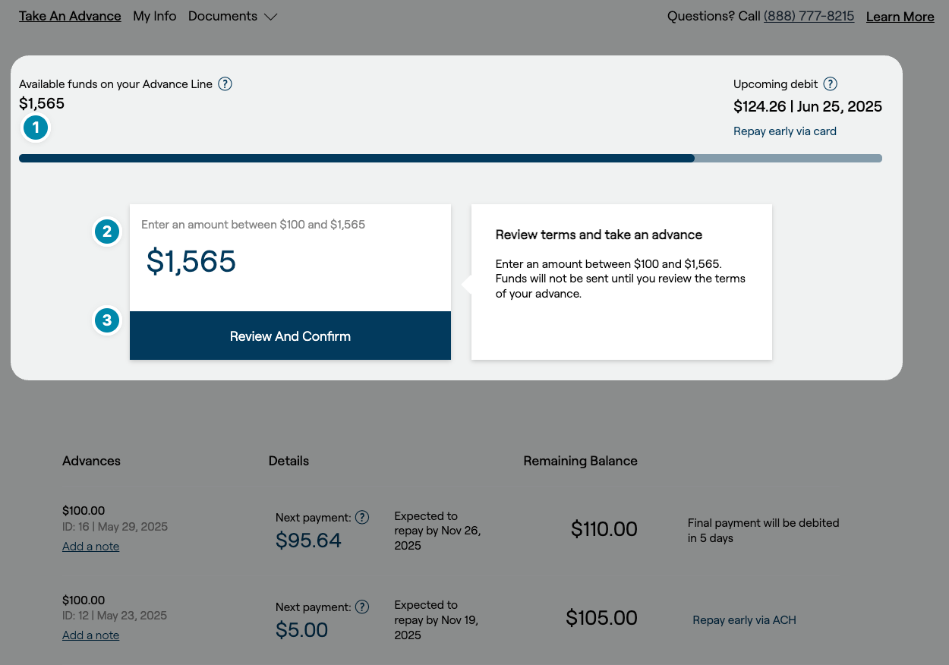
Subsequent draws
The SMB may have several active draws at the same time!
The advance line graph will indicate if there are available funds to draw
The SMB enters in the dollar amount they wish to draw (as little as $100), then clicks Review and Confirm.
The SMB will see the repayment terms and accept them to finalize their draw.
Notes:
You can identify opportunities, passively, by looking at account transactions. And your customers don’t even have to be physically present to see these opportunities.
There are several hundred customers within a typical bank that use third party payment apps to get paid, which makes a perfect opportunity to make them aware of our new solution!
Does your customer receive regular deposits from Square, Venmo, PayPal, Stripe, etc? This new solution offers the same features as these payment apps, but with the added benefit of being a part of their bank account.
No juggling multiple applications and multiple login credentials to different apps and websites.
Payments go right to the customer’s bank account instead of being held in a third-party virtual wallet.
No more manually matching deposits to outstanding invoices
-----------------------------------------------------------------------------------
Another way that you can identify customers is to think about the services they would benefit from.
Again, this does not have to be done “in-person” but it can serve as a middle ground between in-person conversations and passively thinking of customer opportunities.
If your customer needs (CLICK FOR ANIMATION, READ BULLETS AS THEY APPEAR).
Some business type examples include (CLICK FOR ANIMATION, READ BULLETS AS THEY APPEAR).
If your customer has a business like these, or needs these services, it’s great to be proactive in conversations with them and moving them towards enrollment.
-----------------------------------------------------------------------------------
Here are some circumstances you can listen for when talking to your customer that indicate Autobooks may be a good fit for them:
Chaos: do you know a customer that is struggling to keep up with managing their business? Maybe they’re falling behind on collecting overdue payments from customers, or maybe they’re spending hours and hours manually tracking payments and creating invoices. Autobooks technology automates many manual tracking steps for a business.
Trust: Some customers have tried other third-party payment apps and have had a negative experience. Bad customer support, tech issues, or just too difficult to use. Autobooks appeals to customers that have been burned in the past since the solution is baked right into their bank account. Customers know they can trust the services you provide, and they love your customer service. Plus, you’ve got the Autobooks team providing great customer service too!
New Beginnings: It’s a great time to discuss Autobooks when you open new customer accounts! The solution is easy to use, and easy to get started…and priced right for new business owners.

Slide 18
What Makes Autobooks Capital Different
Underwriting performed on DDA activity, not just activity within Autobooks.
No pre-payment penalties. Discounts for early payoff of advances.
Access approved advance capital as a single advance, or as smaller advances of $1,000 and above.

Slide 19

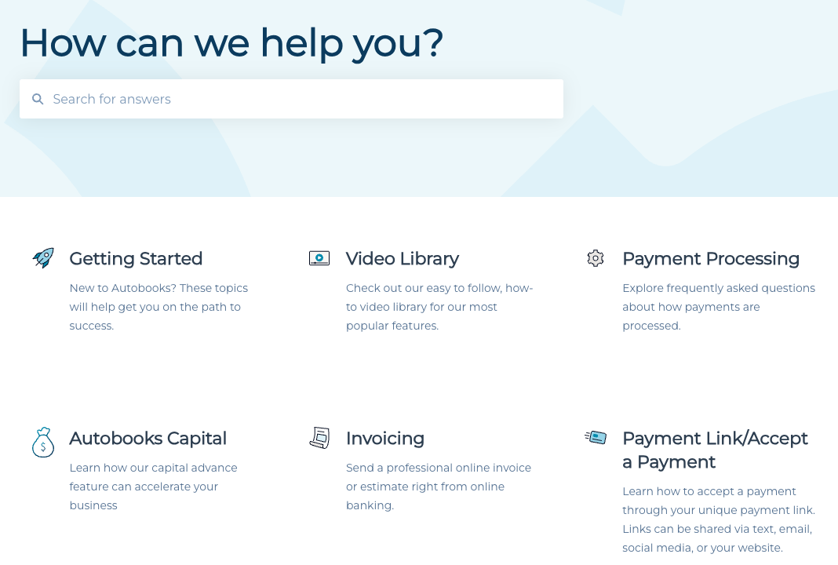

Thanks for watching!
To learn more, visit our knowledge base.
Be sure to check out all our Feature Highlight learnings and use our knowledge base for all things Autobooks!
Notes:
*AUTOMATIC ANIMATIONS ON THIS SLIDE
There are a number of additional support resources available as well including:
- Application Knowledge base built right into the Autobooks tools. This knowledge base houses many support articles with how-to’s, walkthroughs, screenshots, guides and more.
- In addition to the articles, customers and small business owners can submit a web ticket directly through the knowledge base to our support team.
- Also, the Autobooks Support team is available by phone Monday thru Friday, 9am – 6pm ET.
---
GO TO NEXT SLIDE.

