Slide 1


Basics of Autobooks
Accounting
What You’ll Learn

Slide 2

What You’ll Learn
The Benefits of Autobooks Accounting
How the customer accesses it
Feature Overview
Available Resources and Support

Slide 3

The Benefits of
Autobooks Accounting

Slide 4

Picture this…
Alex is a free lance makeup artist. She works nights and weekends, sometimes for long hours. She needs to track her spending on makeup supplies, travel to her jobs, and her payments.
Alex knows she needs to track all these things for tax purposes and to know if she’s profitable…but who has time for that?!? Plus, she’s a makeup expert NOT an accountant!
What can YOU do to help Alex?

Slide 5
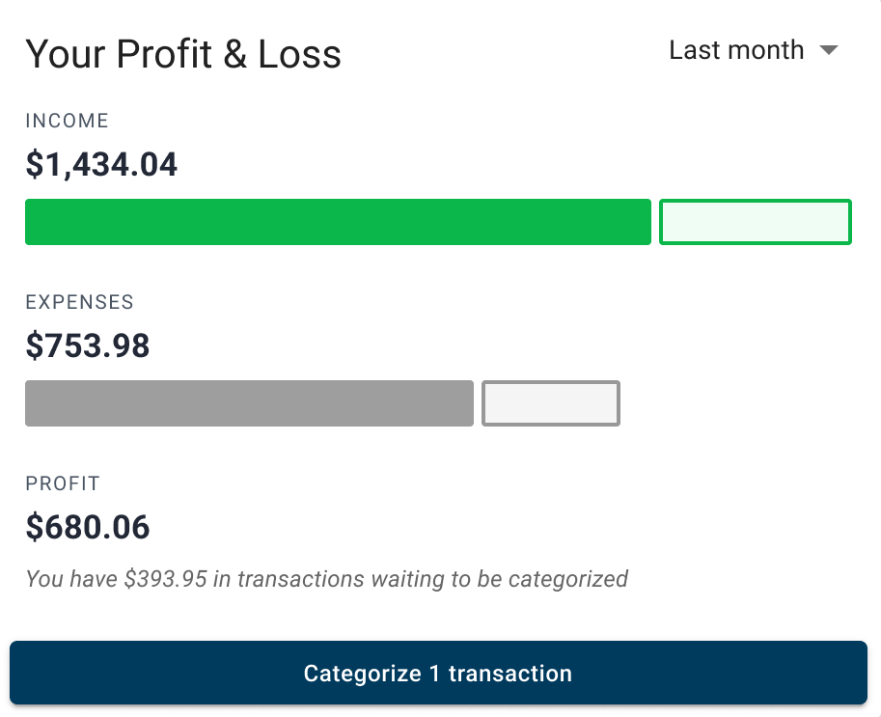
Every business needs accounting tools and…
They should be easy
Access right inside online or mobile banking
Workflows to help categorize expenses and income
Add other business accounts to see a holistic accounting view
Stop relying on pen and paper, spreadsheets, or complicated third-party software built for accountants

Slide 6
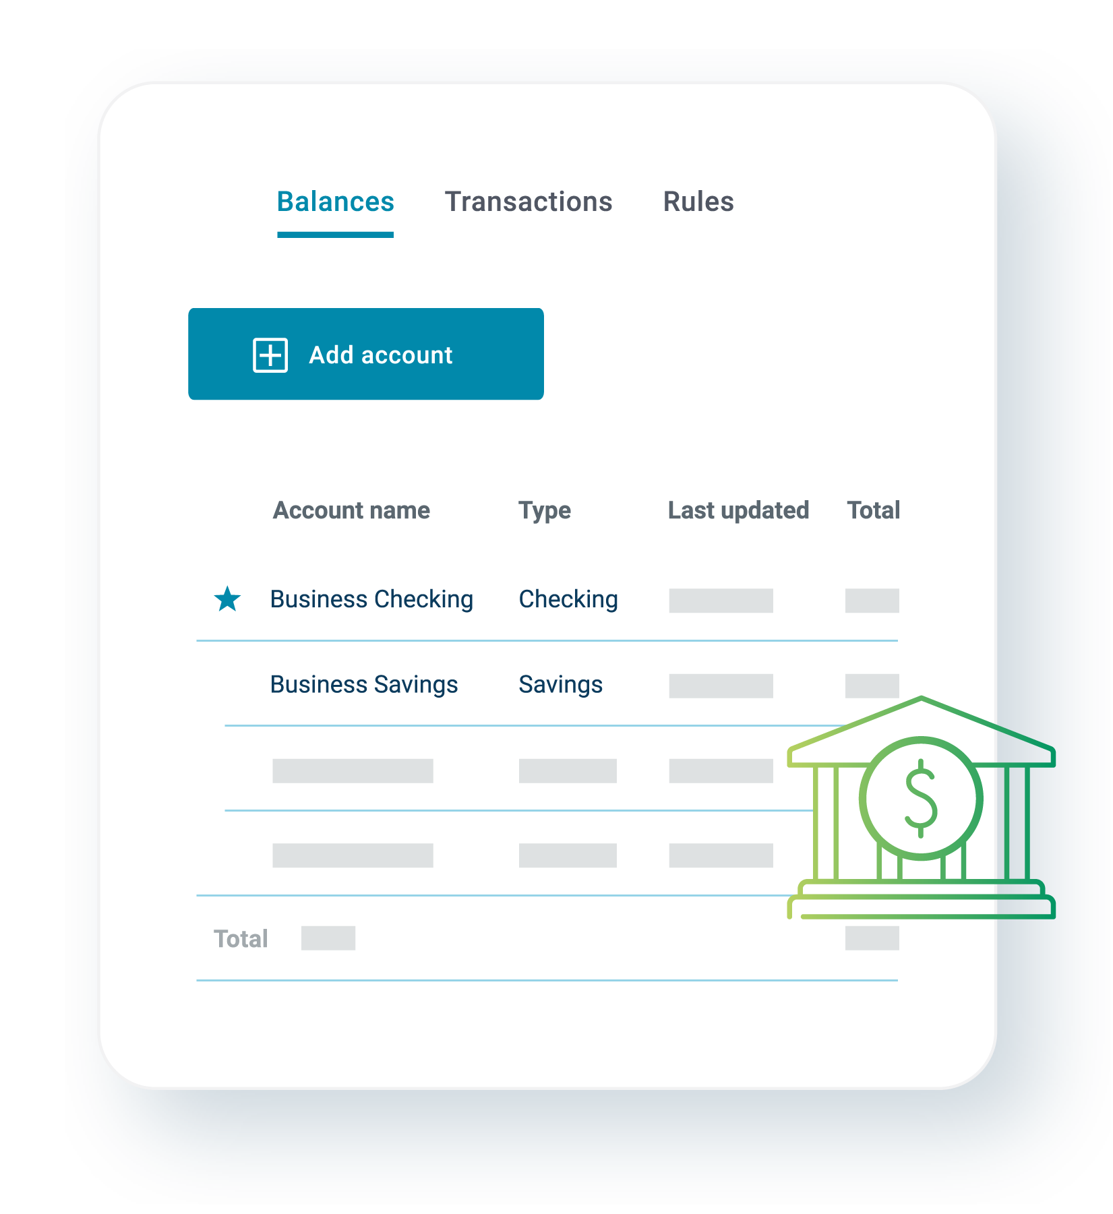
Every business needs accounting tools and…
They should be automated
Transactions automatically appear – no need to upload/download bank info
Autobooks payments are easily matched with deposits
Budget plans are tracked as expenses are identified

Slide 7




Third-party providers are more costly and may be too complex for a smaller business.
Many providers charge extra for customer support.

Slide 8

Now YOU can write a happy ending to the story
Remember Alex, that was short on time and accounting expertise?
When you provide her with Autobooks Accounting she'll be able to easily and quickly track her expenses and income, all in one place.
She can categorize transactions, see her profit, and create a budget plan to keep her growing business on track!
Now Alex uses Autobooks Accounting from her laptop or her mobile phone, from wherever she is.

Slide 9
How to access Accounting

Slide 10

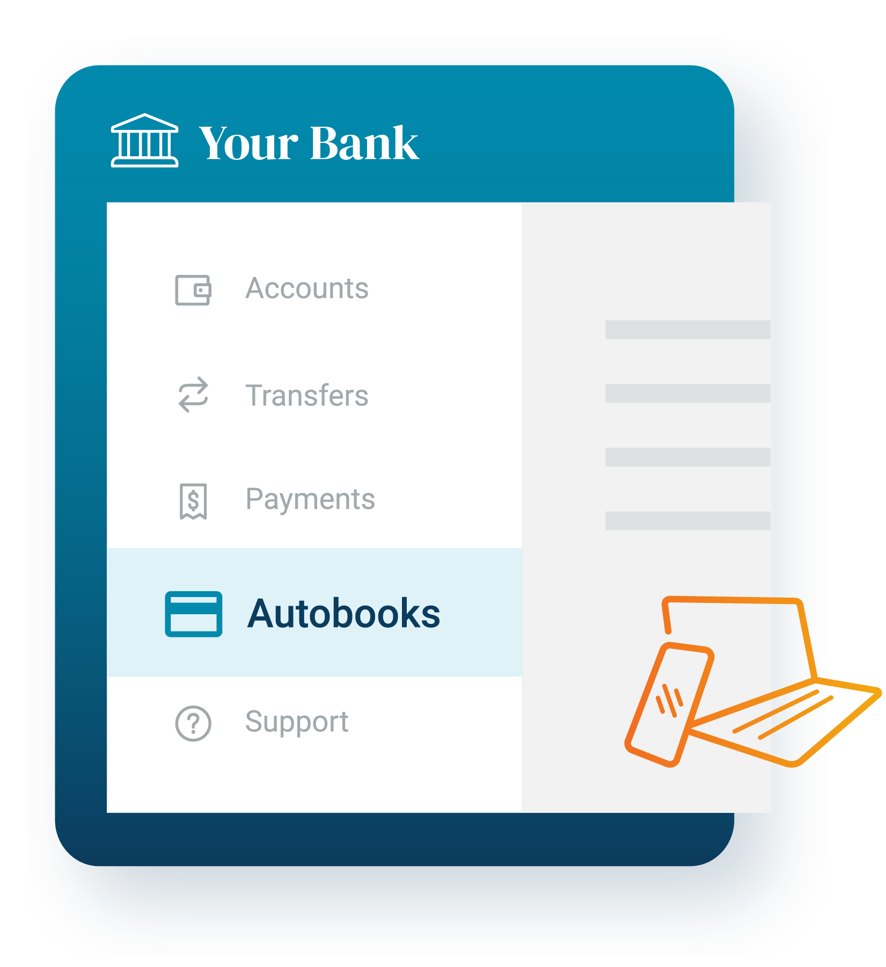
Sign up for Autobooks
The customer will click on Autobooks (or one of our payment tools) inside of your online banking site or mobile app.
From there, they will:
Accept our terms and conditions
Answer a few basic questions about themselves and their business

Slide 11
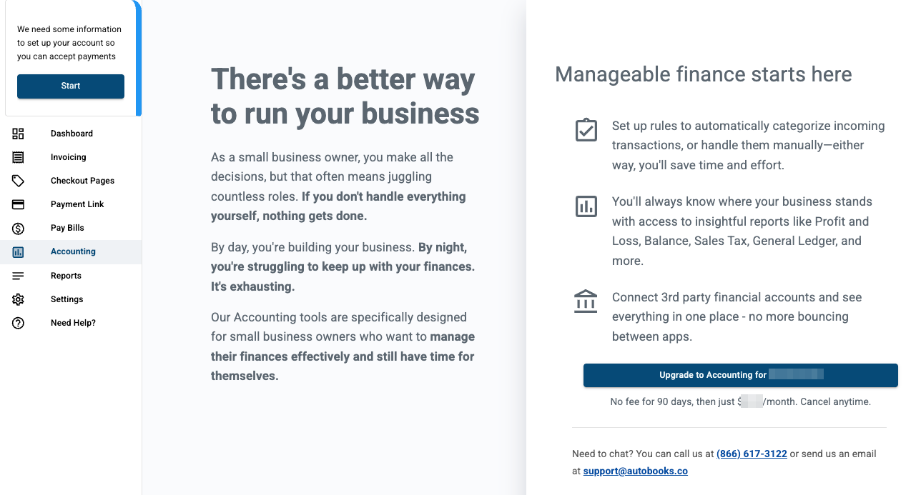
Upgrade to our Premium Plan
Once the customer has enrolled, they can upgrade to our Premium plan immediately!
To upgrade:
Navigate to the Accounting tab
Click the Upgrade button
Our monthly subscription fee is charged 30 days after the customer upgrades.

Slide 12
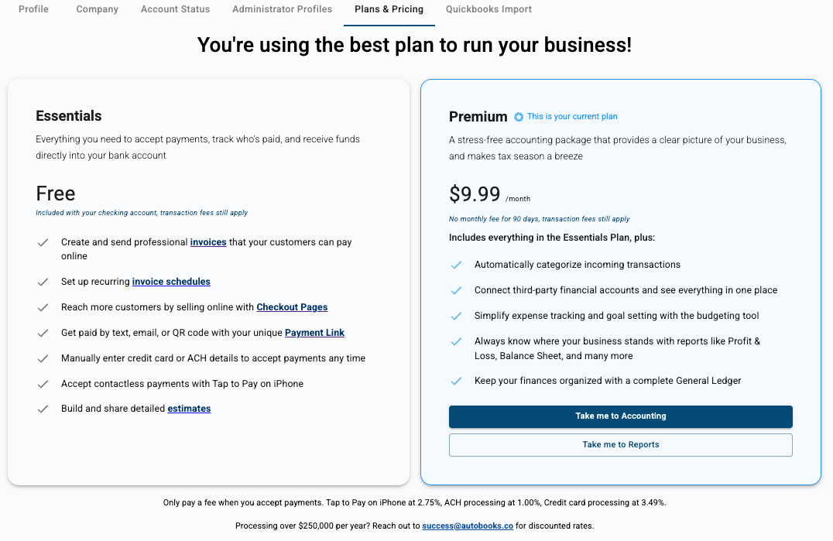
Manage plans
The customer can change back to the Essentials plan at any time!
No minimum subscription months, no contract to sign.

Slide 13
Feature Overview

Slide 14
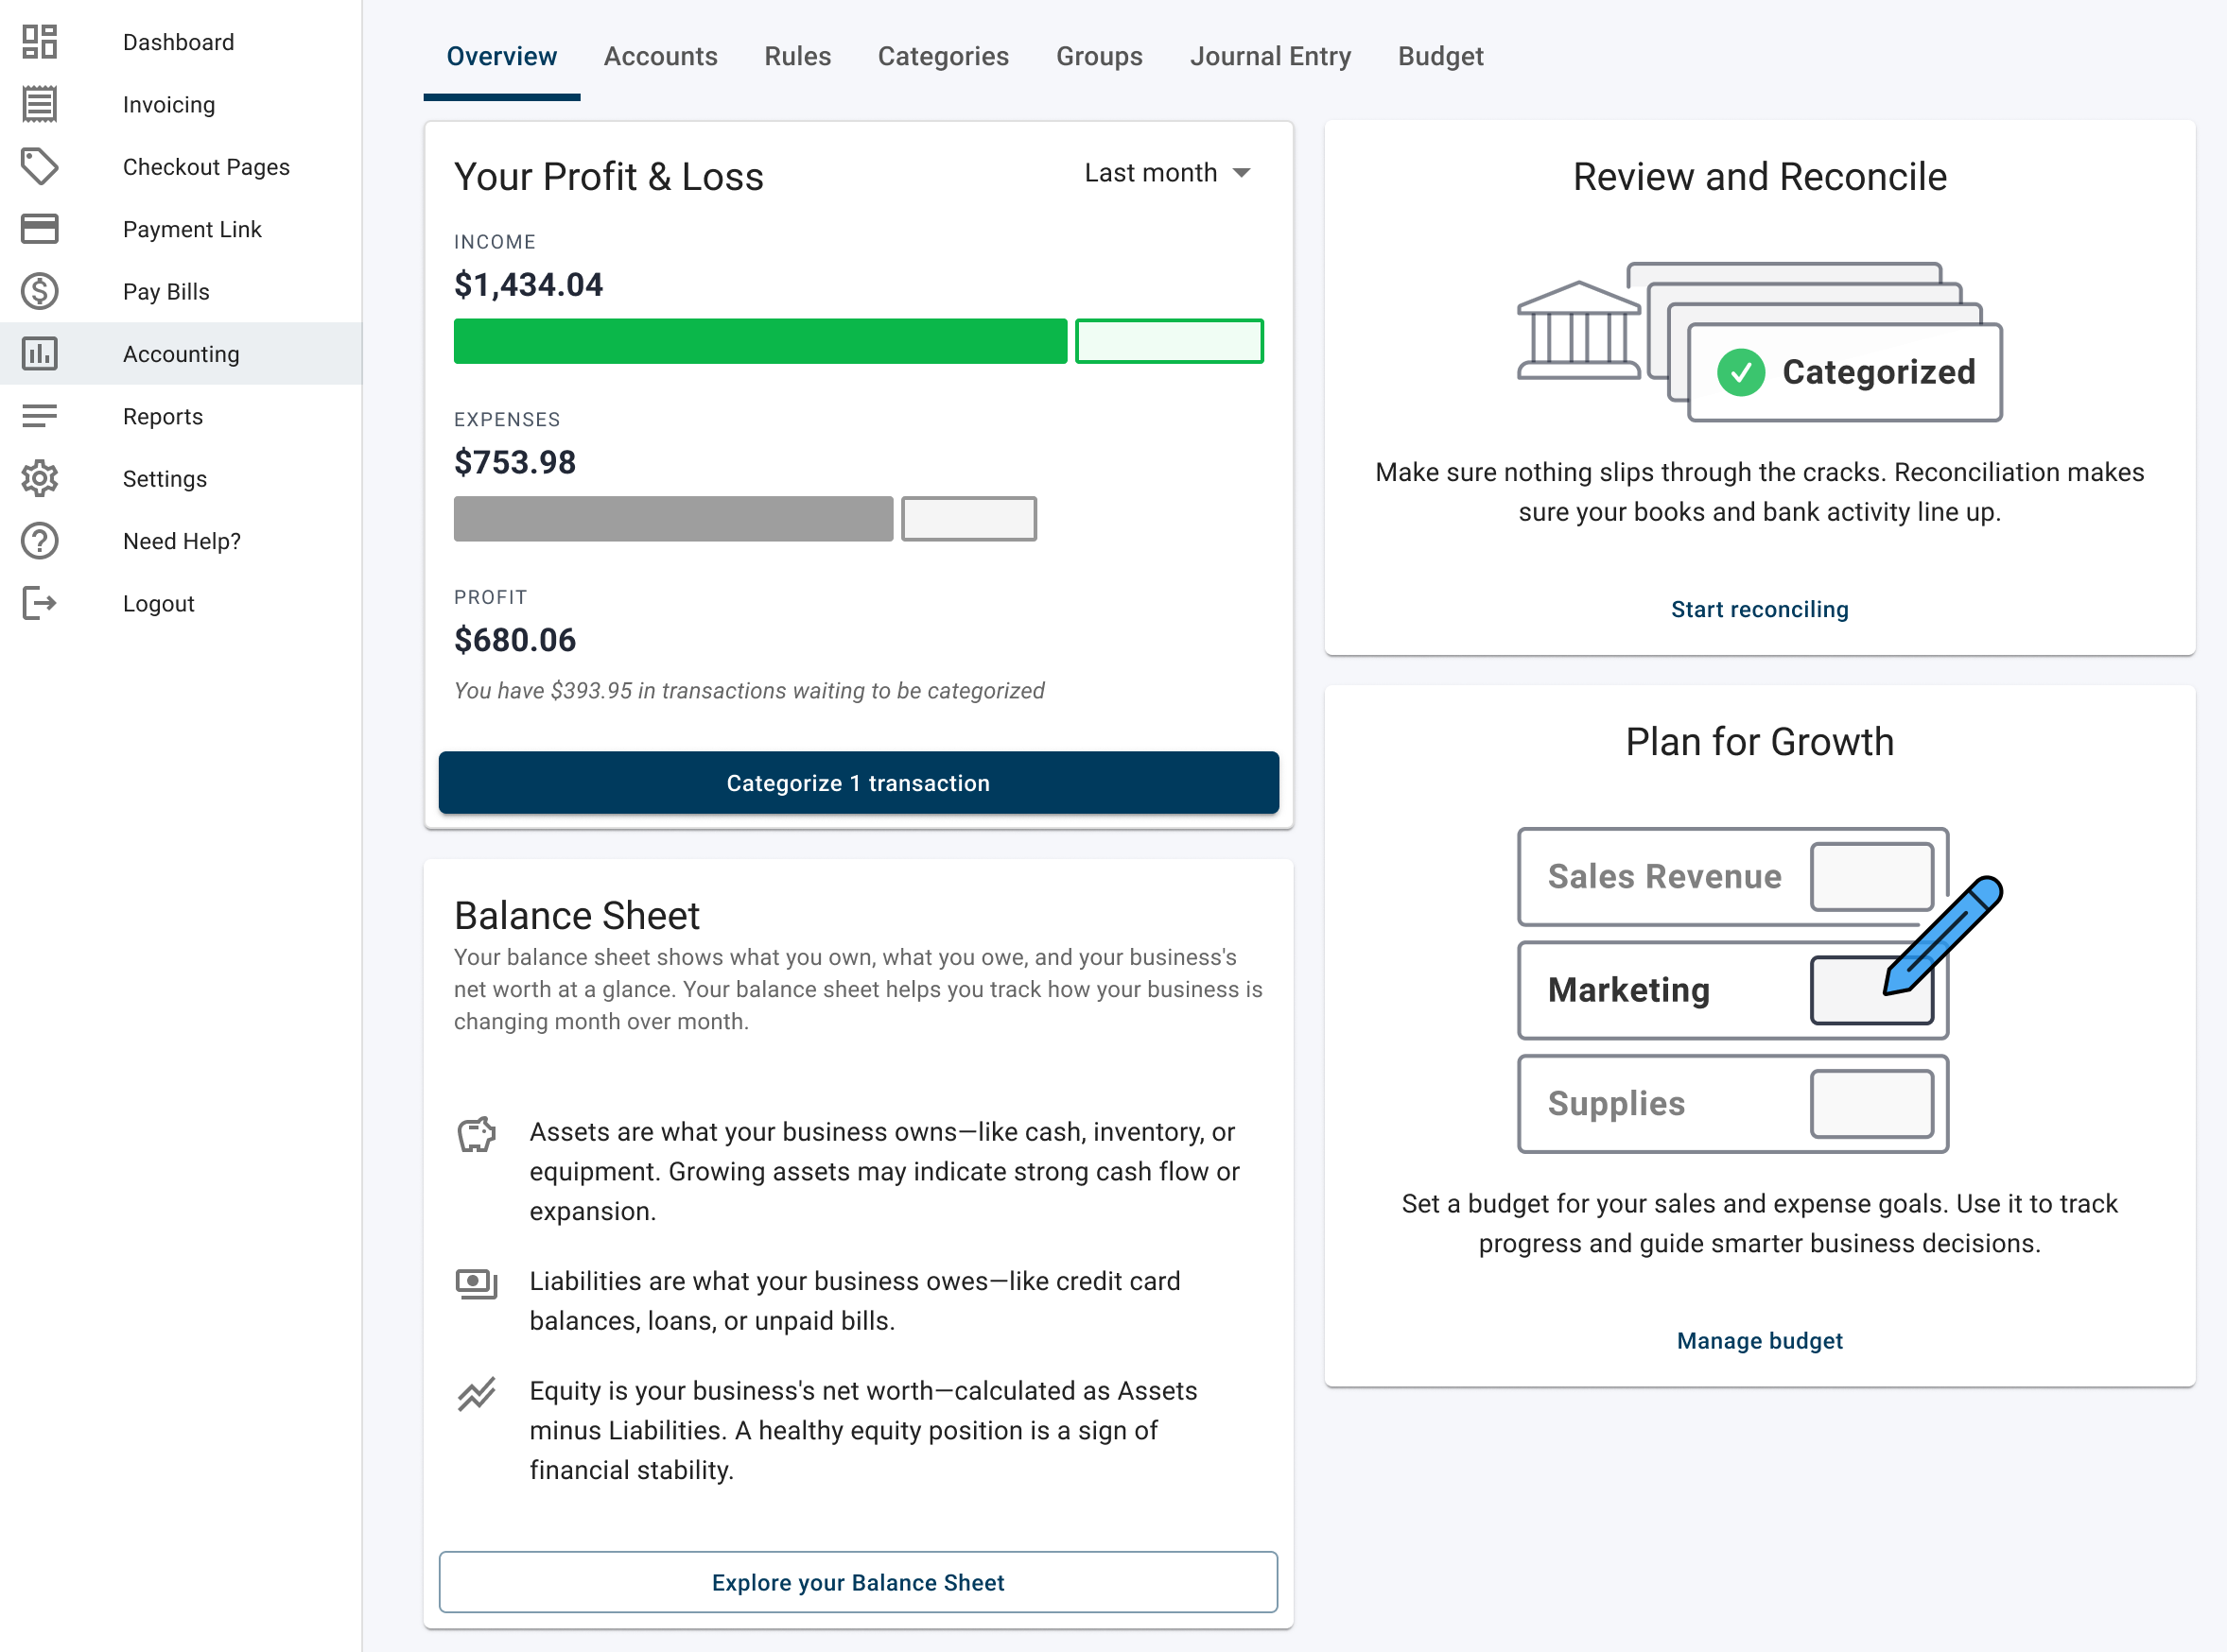
Accounting Insights
Customers can quickly see their Profit & Loss summary and categorize outstanding transactions from our Insights tab.

Slide 15
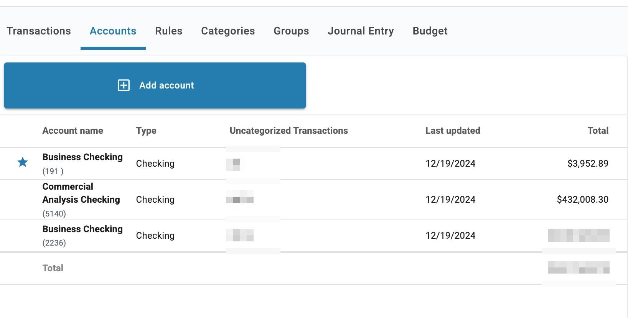
Add other business accounts
Customers can add non-financial institution accounts to their Autobooks view.
This creates a holistic view of all business activity, right in online banking.

Slide 16
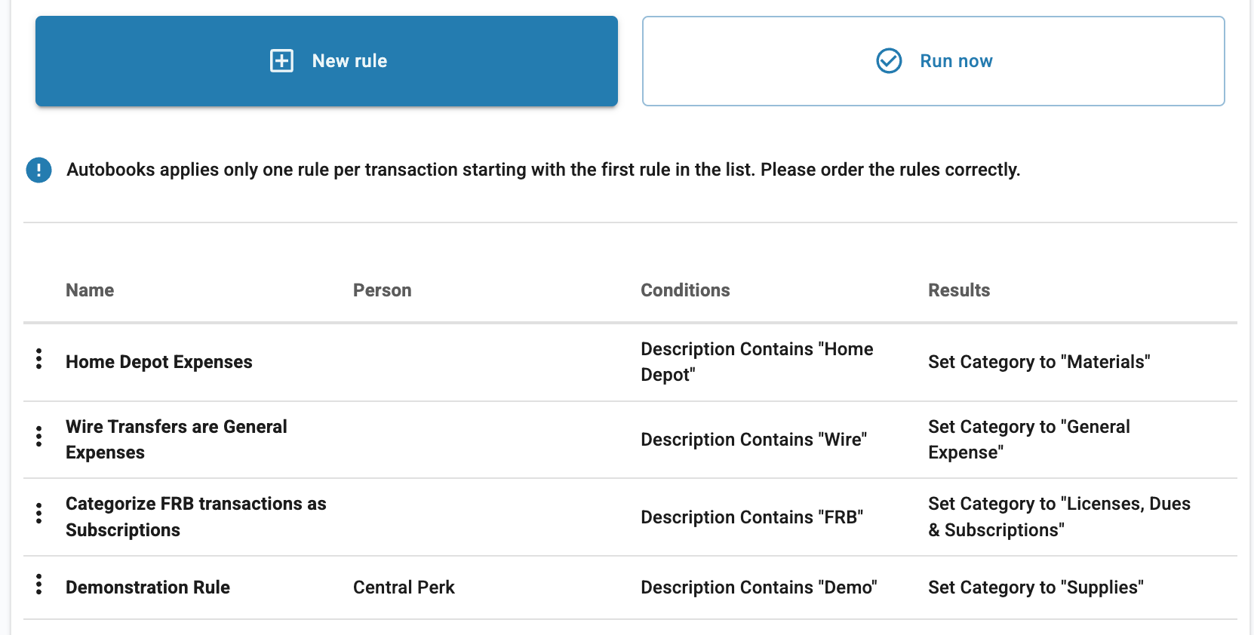
Automate transaction categorization
Customers can create automated categorization rules to save time in manually assigning transactions to a category.

Slide 17
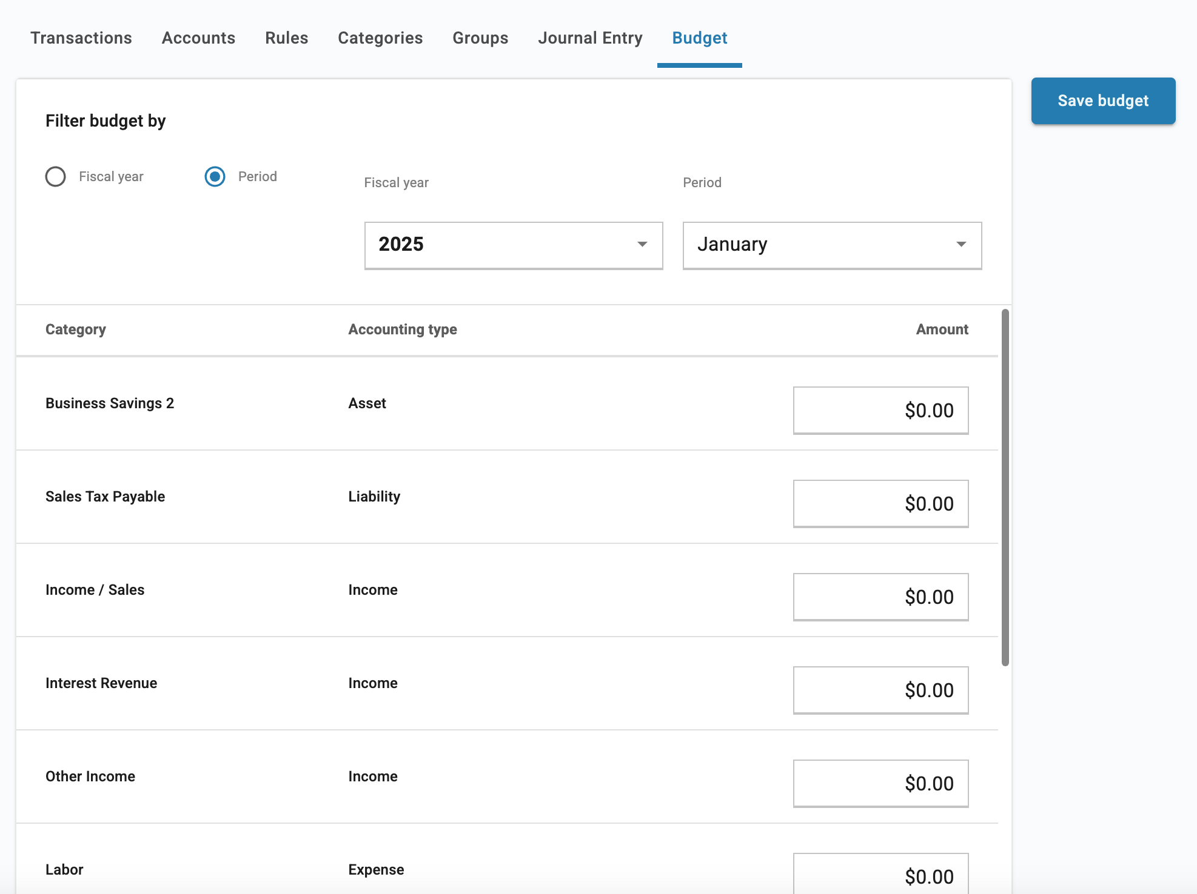
Create a budget
Customers can create a budget to better manage spending and achieve profitability goals.

Slide 18
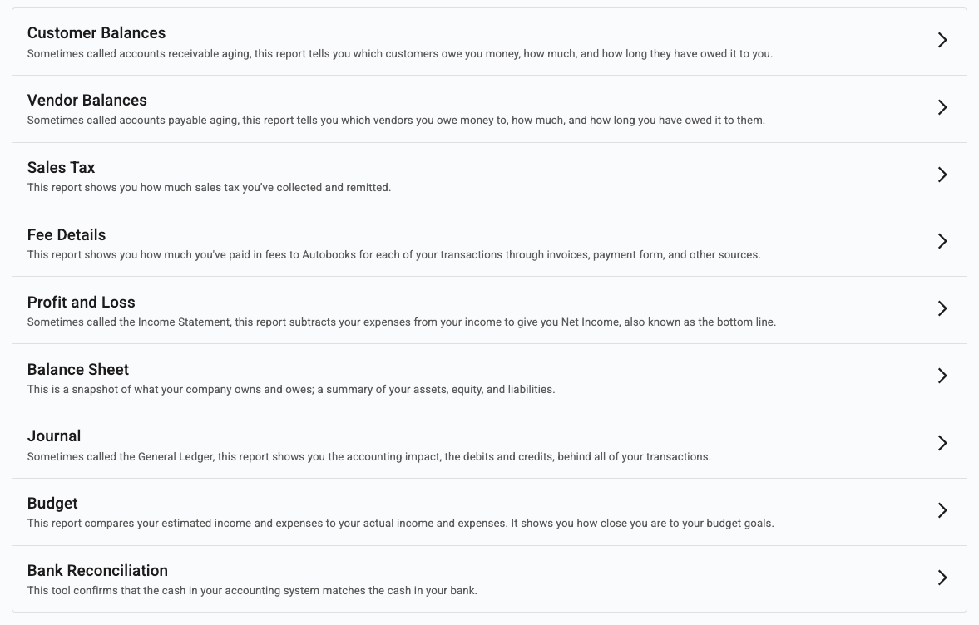
Access financial reports
With our Premium plan, customers gain access to vital financial reports.

Slide 19
What Makes Autobooks Accounting Different
Lives inside of online banking.
No third-party apps to manage, affordable option for small business.
Perfect for tracking expenses and managing to a budget.

Slide 20

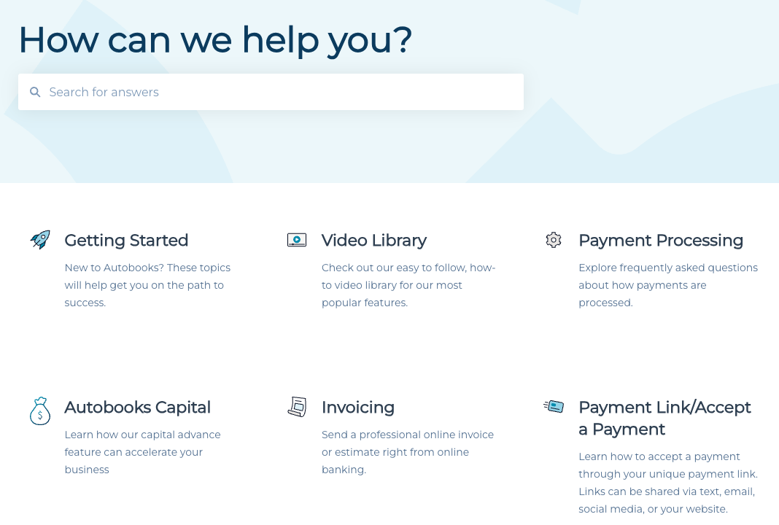

Thanks for watching!
To learn more, visit our knowledge base:
https://help.autobooks.co
Be sure to check out all our Feature Highlight learnings and use our knowledge base for all things Autobooks!

