Slide 1

Autobooks is already inside your bank account – and it’s ready to work for you
Get Paid Faster,
Run Your Business Smarter.

Slide 2
Here’s what we’ll cover
Business Challenges
How Autobooks can help
Features for businesses like yours
Pricing (it’s simpler than you think)
How to get started

Slide 3
Business Challenges
3
Notes:
Let’s talk about how Autobooks can also add significant value to your financial institution.
---
GO TO NEXT SLIDE.

Slide 4

Getting paid shouldn’t be difficult
You finish the job. The work is done. But the money?
It shows up when the customer gets around to it, or when you follow up.
Revenue comes in project by project
Payment timing is unpredictable, and cash flow suffers
Chasing down late payments eats up time you don’t have

Slide 5

Your customers want to pay you with cards or bank transfers
Most customers today prefer to pay by credit card or bank transfers – but too many businesses are still stuck accepting checks or cash
75% of subcontractors still get paid primarily by paper check
Customers expect the same easy payment experience they get everywhere else
Many younger consumers don’t own a checkbook

Slide 6

Admin work is stealing hours from your day
Between writing invoices, chasing payments and tracking payments, and making bank deposits…the paperwork is never-ending
Paper invoicing takes hours of manual effort to create and track
Spreadsheets and ledgers lead to missed or lost payments
Running around town to pick up payments? That’s time you could be billing to another project

Slide 7
Here’s the good news
You don’t need to sign up for another app, create a new account, or login to an unfamiliar system.
Autobooks is already built into your bank account – and it’s free to get started.

Slide 8
How Autobooks can help
8
Notes:
Let’s talk about how Autobooks can also add significant value to your financial institution.
---
GO TO NEXT SLIDE.

Slide 9
Autobooks Plans
LOG INTO
ONLINE BANKING
1
The customer (business owner) will use existing credentials for their business account to log into online banking.
Self-serve Enrollment | No Contracts | Change plans at any time
Autobooks Essentials
Autobooks Premium
At enrollment:
Invoicing
Payment Link
Checkout Pages
Tap to Pay*
Autobooks Capital*
Payment Reports
Self-service upgrade
Essentials features PLUS:
Accounting
Financial Reports
*Not offered by all financial institutions
Setup: Enrollment

Slide 10
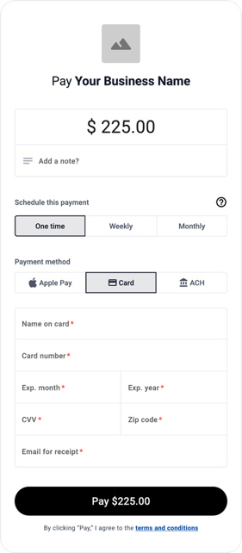
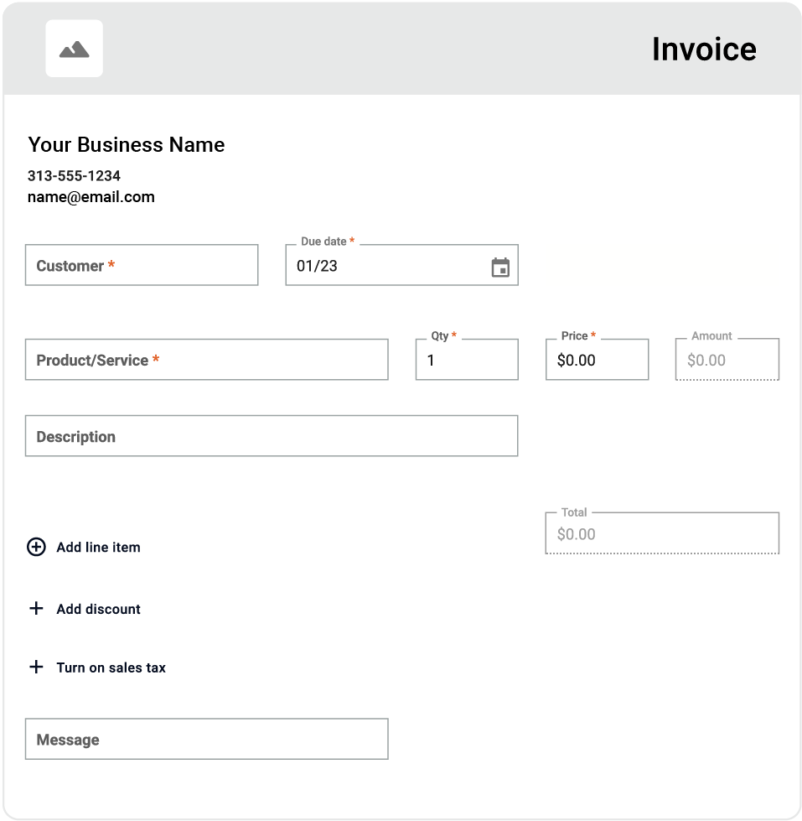
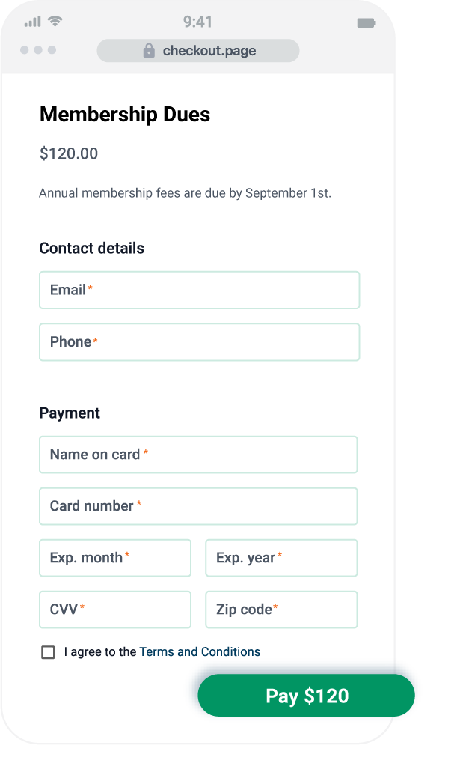
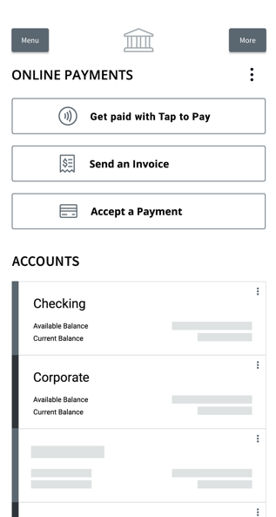

Autobooks Essentials: Payment Features
PAYMENT LINK
INVOICING
CHECKOUT PAGES
TAP TO PAY

Slide 11
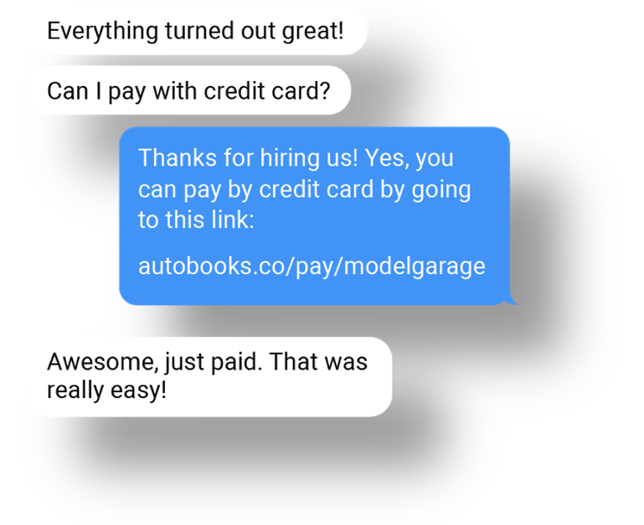
Share Payment Link
Send a payment link to customers via:
Email
Text messages
QR Code
Embedded website or social media link
To learn more about Payment Links, click here.

Slide 12
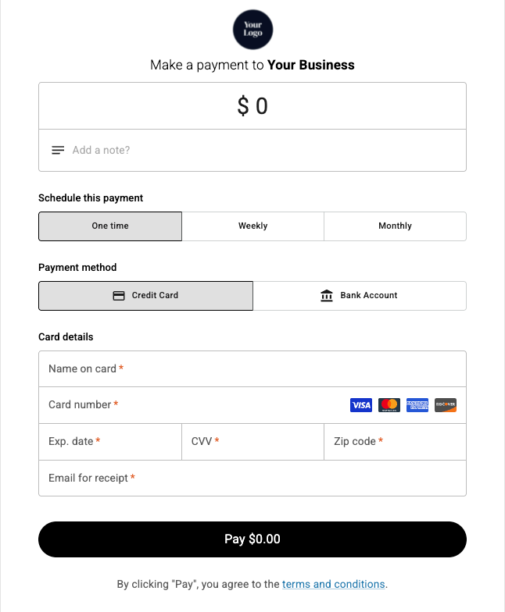
Track Payments
Customers pay securely through a branded payment form:
Track payment status in real time
Download payment info for your records
Funds deposit directly to your account
To learn more about tracking payments, click here.

Slide 13
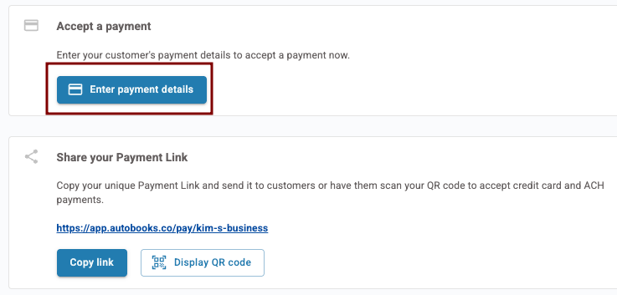
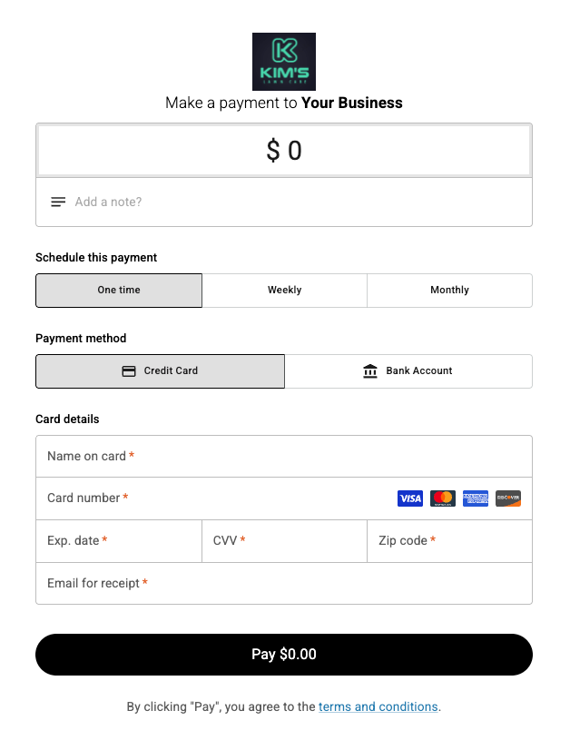
Payment Link/QR Code
Accept a payment directly inside of online banking
Great for securely taking payments over the phone!
Display QR code on paper invoices to give customers payment options
To Learn more about our Payment Link and QR Code, and how they work, click here.

Slide 14
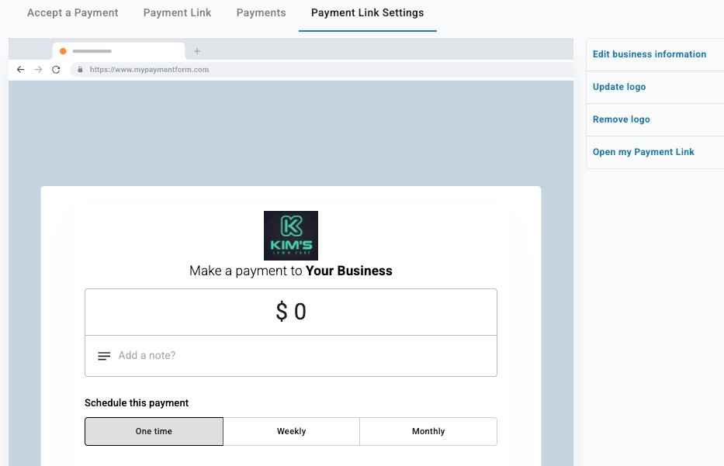
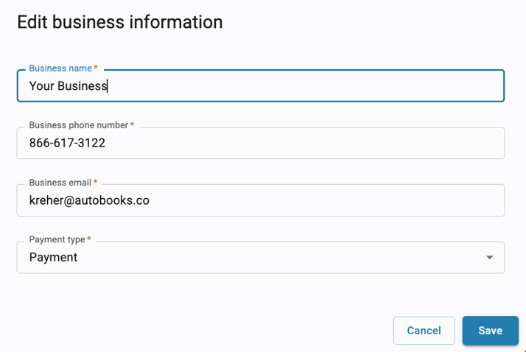
Payment Link/QR Code
Customize the payment form with business logos and special instructions
To Learn more about our Payment Link and QR Code, and how they work, click here.

Slide 15
What problems does Payment Link solve?
FLEXIBILITY:
Take payments via credit/debit, Apple Pay, or Bank Transfer
LESS ADMIN WORK:
Payment form is easy for customers to complete, payment receipts sent automatically
FITS INTO EXISTING PROCESSES:
Include Payment Link in paper invoices to give customers options
SECURE PROCESS:
Employees can share the link as needed, customer payments are secure
To Learn more about our Payment Link and QR Code, and how they work, click here.

Slide 16
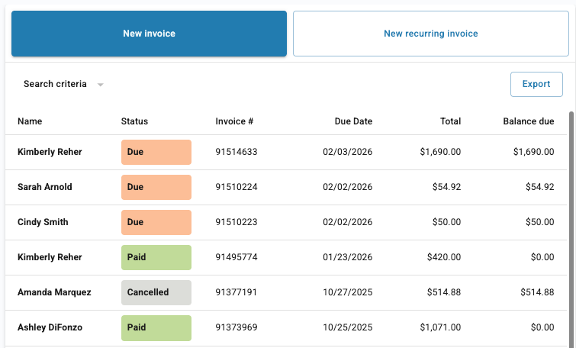
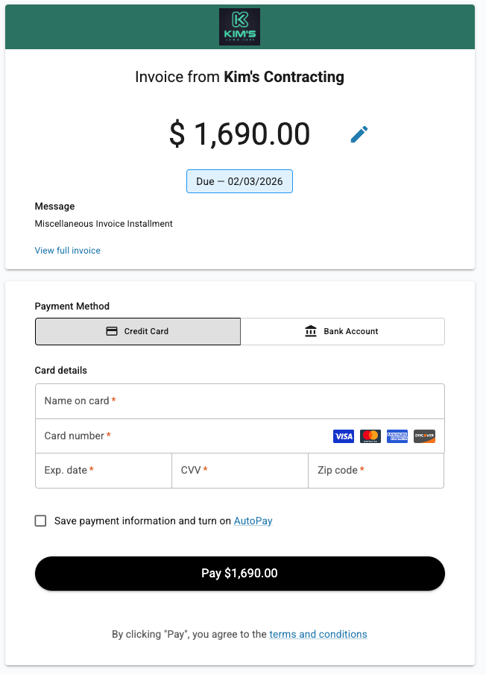
Invoicing
Build, email, and track single and/or repeating invoices all in online banking
Include attachments
Track all invoice payment statuses (even cash and check payments)
To Learn more about our Invoicing tools, and how they work, click here.

Slide 17
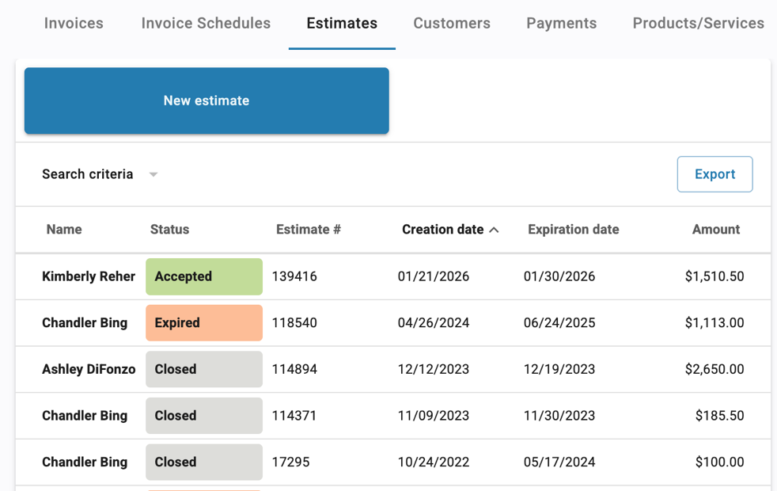
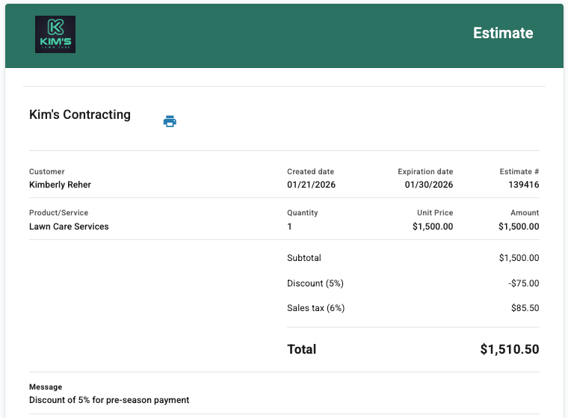
Invoicing
Create, email, and track estimates
Track all estimate statuses
Track estimate expiration dates
To Learn more about our Invoicing tools, and how they work, click here.

Slide 18
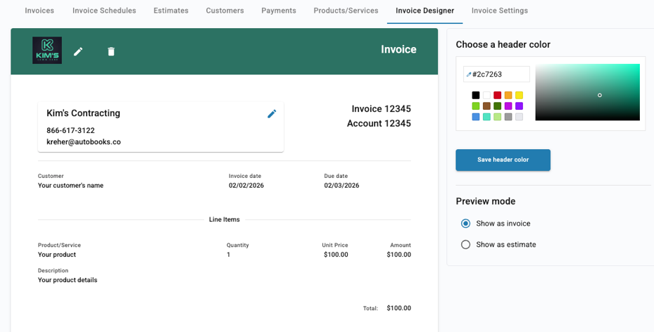
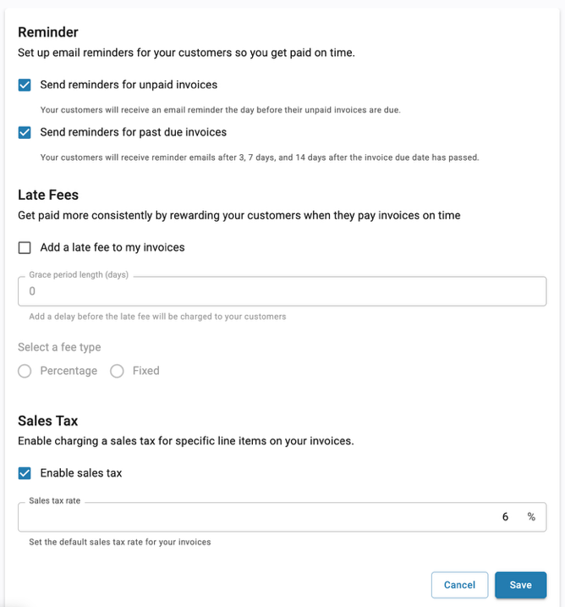
Invoicing
Customize invoice template
Enable automatic payment reminders and late fees to save time on payment follow-up
To Learn more about our Invoicing tools, and how they work, click here.

Slide 19
What problems does Invoicing solve?
PAYMENT TRACKING:
See invoices statuses all in one list, even track cash/check payments
LESS ADMIN WORK:
Automatic payment reminders cut down time spent hunting down late payments
TRACK ESTIMATES/QUOTES:
Track quotes in one place, with clear expiration dates
FASTER PAYMENTS:
Digital invoices are paid within 5 days of receipt on average
To Learn more about our Invoicing tools, and how they work, click here.

Slide 20
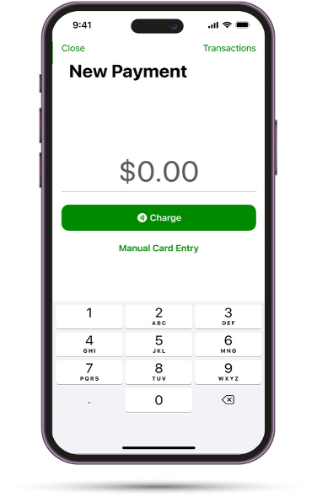
Tap to Pay
Screenshot 2025-04-09 at 9.49.31 A
Get paid right from your iPhone
Accept credit and debit cards, digital wallets
No extra software, no hardware needed
Requires iPhone XR or later
To learn more about Tap to Pay click here.

Slide 21
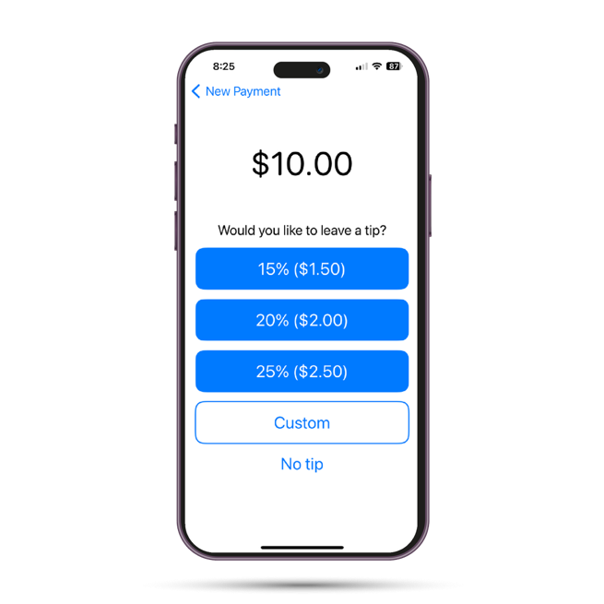
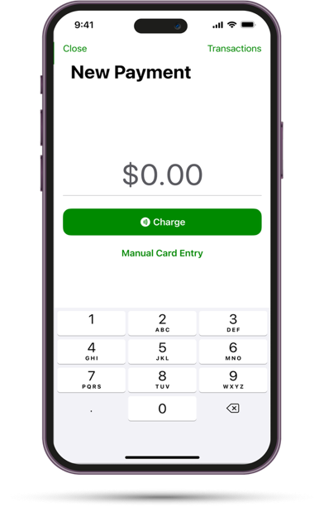
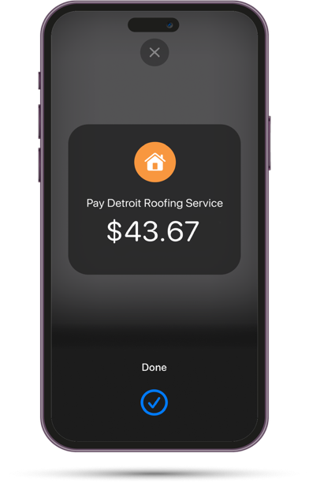
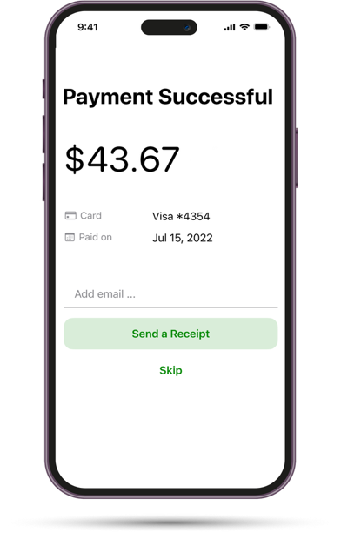
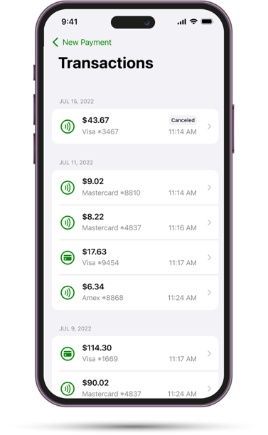

Accepting a Tap to Pay on iPhone Payment
Start a Transaction
Add a Tip (optional step)
Take Payment
Send Receipt
Viewing Transactions
Click into Tap to Pay to begin a transaction. Enter your price, then click Charge.
Customer holds their card or digital wallet near the iPhone and waits for the success screen
Once complete, send a receipt via text or email

Slide 22
What problems does Tap to Pay solve?
TAKE PAYMENTS IN PERSON:
Take payments in the moment, avoid slow payors
DEPOSITS:
Take deposits when contracts are signed
TECH IS EASY:
No extra hardware needed, just online banking + iPhone
EMPLOYEES CAN USE IT:
Set employees as sub-users of Autobooks to access Tap to Pay
To learn more about Tap to Pay click here.

Slide 23
Better Efficiency
LOG INTO
ONLINE BANKING
1
The customer (business owner) will use existing credentials for their business account to log into online banking.
Track all payments with one app
Track all quotes/estimates (expiration dates, amounts)
Automated payment reminders; automated late fee assessment
Allow sub-admins to access invoicing and payments w/o granting access to the bank account
Invoice in bulk
Reports to track sales taxes charged; processing fees
Setup: Enrollment

Slide 24
Autobooks Pricing:
LOG INTO
ONLINE BANKING
1
The customer (business owner) will use existing credentials for their business account to log into online banking.
A pricing model made simple and easy to understand
No Hidden Fees | No Contracts | No Additional Use Charges | No Required Use Agreements
- Enrollment Options -
- Processing Fees -
Essentials Plan
Premium Plan
Card Not-Present Payments
Card Present Payments
ACH
(Bank Transfer)
Invoices
Payment Link
Checkout Pages
Manual Card Entry
Send An Invoice
Payment Link
Checkout Pages
Tap to Pay
Autobooks Capital
Payment Processing tools
Autobooks Capital
Accounting
Reporting
Tap to Pay
Invoices
Payment Link
NO Monthly Subscription
$9.99 / mo.
3.49 %
per transaction
2.75 %
per transaction
1.00 %
per transaction
Setup: Enrollment

Slide 25
Autobooks
In Action
25
Notes:
Let’s talk about how Autobooks can also add significant value to your financial institution.
---
GO TO NEXT SLIDE.

Slide 26
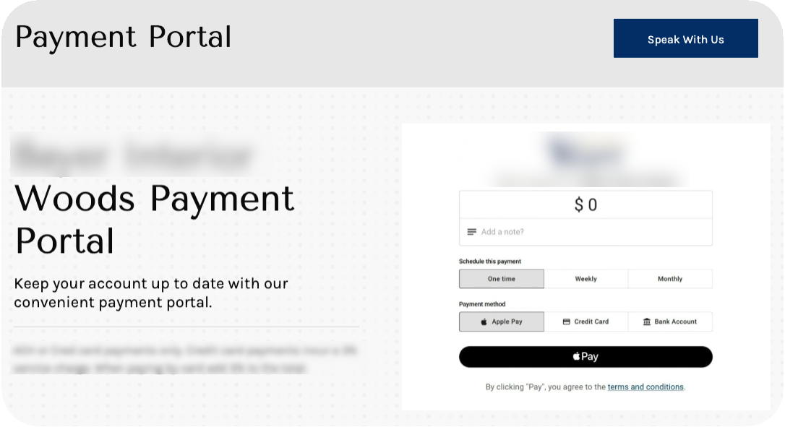
Payment Link in action
  Create a payment portal by embedding the payment link into the company website

Slide 27

Payment Link in action
  Text a link to collect payments quickly

Slide 28
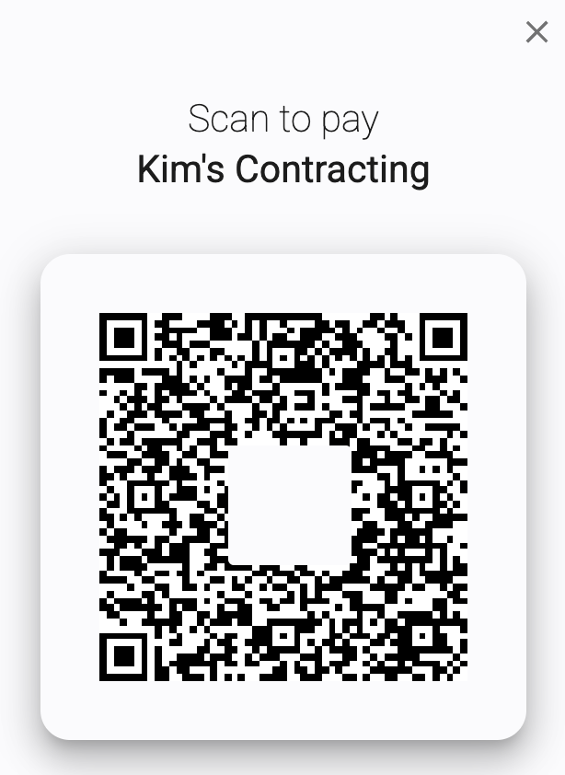
Payment Link in action
  Add QR code to paper invoices, giving customers multiple payment options

Slide 29
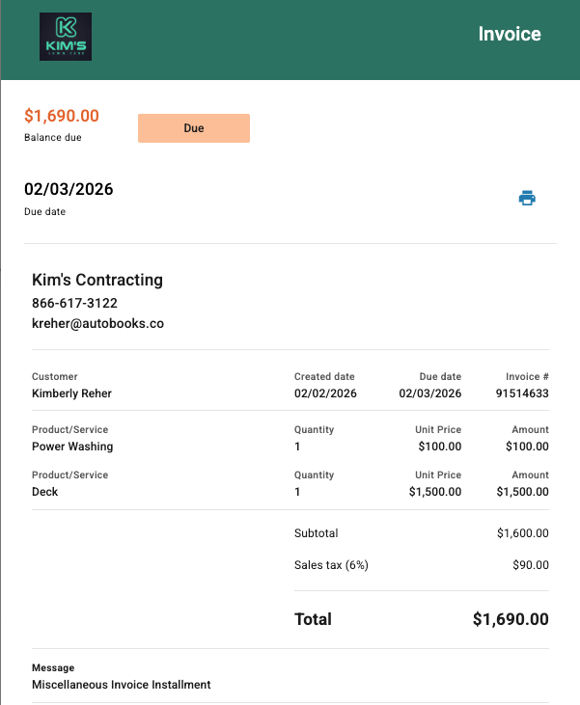
Invoices & Estimates
  Track payments easier, get paid faster! Most digital invoices are paid within 5 days of receipt.

Slide 30

Tap to Pay
  Take a payment
  in-person, right from an iPhone.

Slide 31
Enrollment
31
Notes:
Let’s talk about how Autobooks can also add significant value to your financial institution.
---
GO TO NEXT SLIDE.

Slide 32
Setup: Enrollment
Enrollment takes an average of 8 minutes to complete and is available 24/7!
LOG INTO
ONLINE BANKING
1
The customer (business owner) will use existing credentials for their business account to log into online banking, then click on a Autobooks feature.
ACCEPT TERMS
& CONDITIONS
2
Autobooks Terms and Conditions will appear. The customer will need to read and accept before continuing.
ANSWER BASIC
QUESTIONS
3
The customer will answer basic questions about the business, then wait for in-app and email notification of payment approval from Autobooks.
Notes:
ANIMATIONS ON THIS SLIDE
Enrollment is easy, and usually takes 10 minutes or less! (CLICK FOR ANIMATION)
The first step for the customer is to log in to online banking. (CLICK FOR ANIMATION)
Next, the user will accept Autobooks Terms and Conditions. (CLICK FOR ANIMATION)
At this point, the user is presented with basic questions that Autobooks needs answered in order to approve the business to accept payments through Autobooks. The user MAY click away from the questions to explore the app, but they MUST complete the questions in order to get approved.
Some notes on enrollment:
The customer can sign up right in the branch (if they can log into online banking there) OR
The customer can sign up in online banking 24/7
Once the customer enrolls, they have access to all of the features of Autobooks Essentials plan.
---
GO TO NEXT SLIDE.

Slide 33
Setup: Payment Approval Process
1
Autobooks will run the business data and information through an automated assessment.
ASSESSMENT
* REVIEW *
1*
If the assessment requires a manual review, Autobooks will contact the customer and/or financial institution for more information.
2
The customer will receive an email notifications that they have been payment approved and can start using Autobooks to get paid!
APPROVAL
* DENIAL *
2*
If denied, Autobooks will email the decision to the customer along with instructions to call Autobooks for details.

Slide 34
Resources
34
Notes:
Let’s talk about how Autobooks can also add significant value to your financial institution.
---
GO TO NEXT SLIDE.

Slide 35
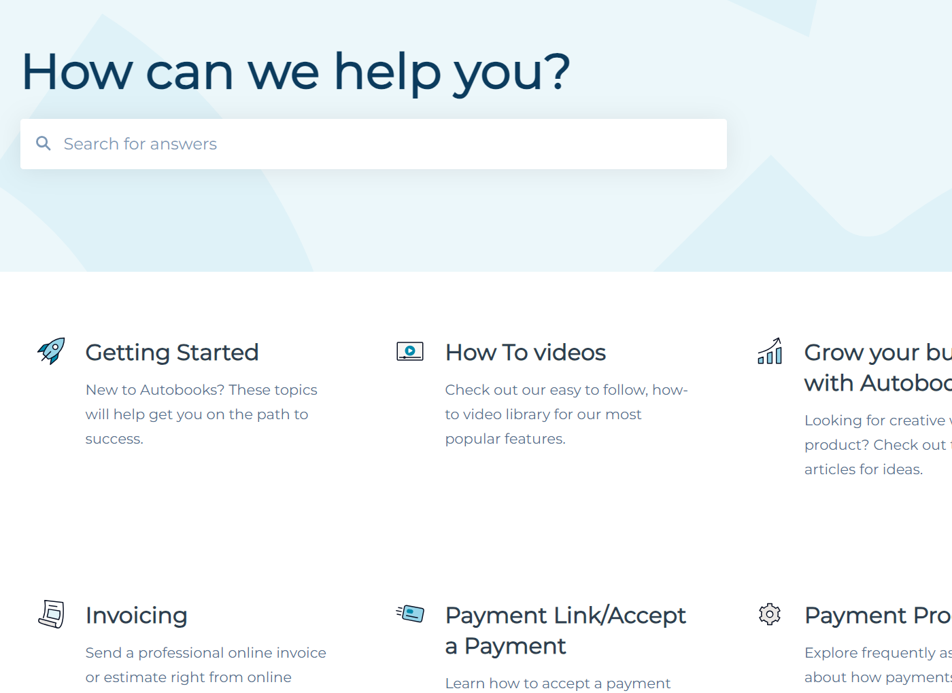
Autobooks Knowledge base: help.autobooks.co
You can find:
    Support articles
    How-to articles
    Submit a ticket

Slide 36
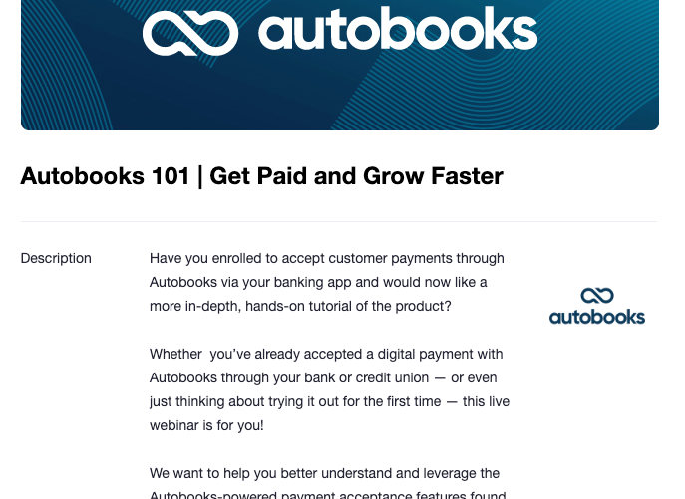
Weekly Training Webinar for your customer
Every Wednesday @ 12PM ET

Slide 37


